Slide 1


Learning Generative Statistical Models
from
Brain Imaging Repositories
Prof. Dr. med. Danilo Bzdok
&
Data Science Workshop
26 October 2015
Notes:
30min!
I would be happy to have your thoughts
INRIA: driving force in machine-learning innovation in academia

Slide 2
Classical regime
High-dimensional regime
n > p
n << p
p
p
n
n
„long data“
„wide data“
Hastie et al., 2001
Notes:
One of the hot topics in datascience appears to be: how to actually define „data science.“ There were tree different approaches that came to my mind.
Nowdays, increase in granularity (Jordan)

Slide 3

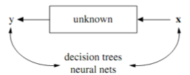
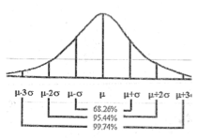
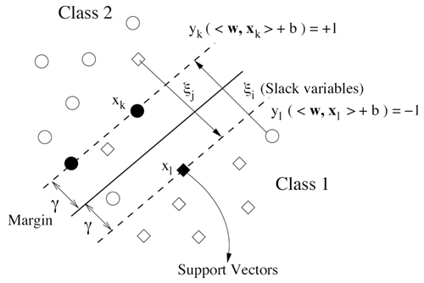
Data modelling
Algorithmic modelling
Breiman et al., 2001
Notes:
I have always been using data-driven methods, but a particular aspect caught my attention about roughly 3 years ago.
classical:
worked well for almost 100 years now
asymptotic results by letting n run against infinity
modern:
Say, n=50 and p=51 -> almost all classical statistical methods are guaranteed not to work anymore.
classical methods do not work anymore; it is not about adding fancy methods, there is actually no alternative.
SPM and other approaches in neuroimaging work mainly because of voxel-wise procedure repeated 300.000 times. Problem has only not been solved but only postponed -> comes back als multiple comparisons problem that has essentially never been solved. Cluster-level inference and more recently TFCE being perhaps best workarounds.
Much effort in the statistical community has been dedicated to solving problems related to wide data.

Slide 4
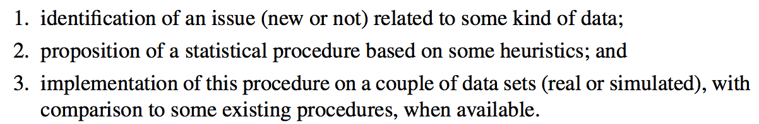
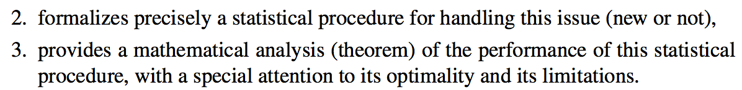
Mathematical Statistics
Data Science
Giraud, 2015
Notes:
One of the hot topics in datascience appears to be: how to actually define „data science.“ There were tree different approaches that came to my mind.
analytical <=> heuristic
kind of ad-hoc fashion
Conclusio: Math before application. Appliation before math.

Slide 5
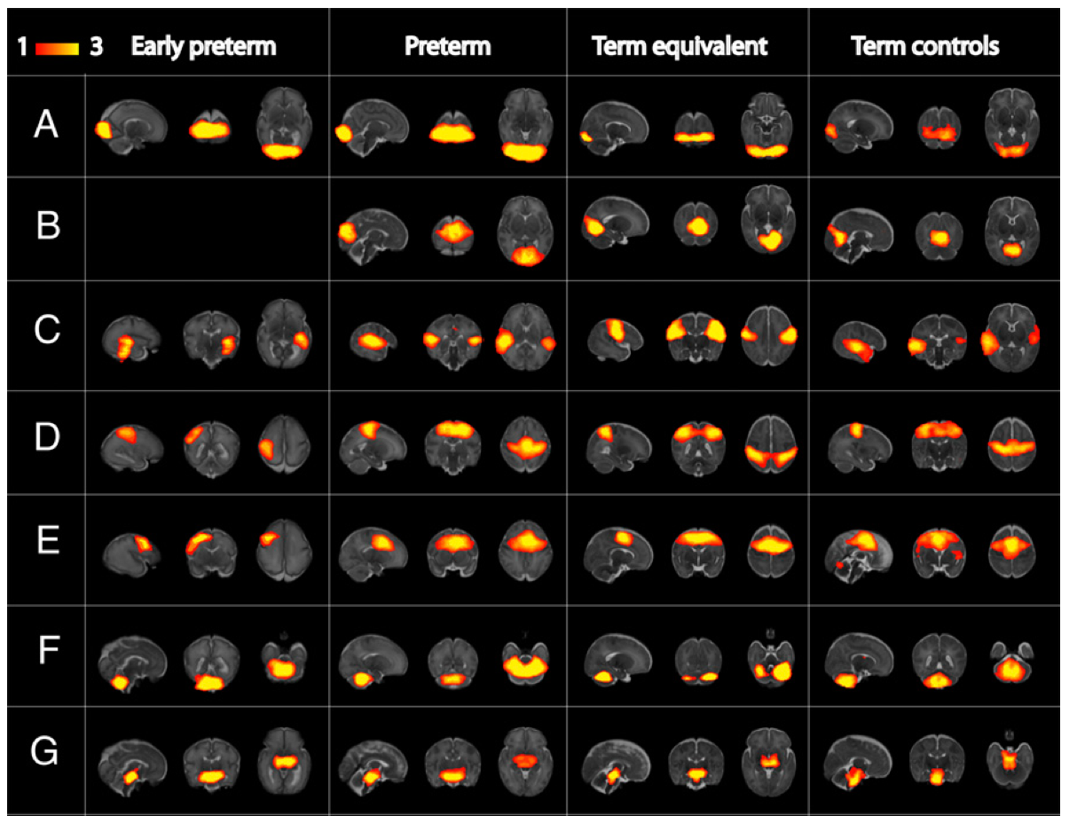
Introduction 1/3
Doria et al., 2010 PNAS
Notes:
We don’t want to do methods to do methods, but try to solve relevant problems in neuroscience
Setting: system neuroscience
Doria and colleagues asked this from an ontological perspective: What comes first - network or cognition?
measured in 70 infants born between 29 and 43 gestational week
As development pro- gressed, cortical activity became more coherent across recognized neuroanatomical systems with a general increase in interhemi- spheric correlation.
Within network connectivity becomes less variable, including DMN
Before term, the DMN was incomplete: In the preterm group, the inferior parietal lobules were not involved
=> RSN networks emerge during fetal growth; esp. 3rd trimester of gestation
=> before maturation of cognitive capacities

Slide 6
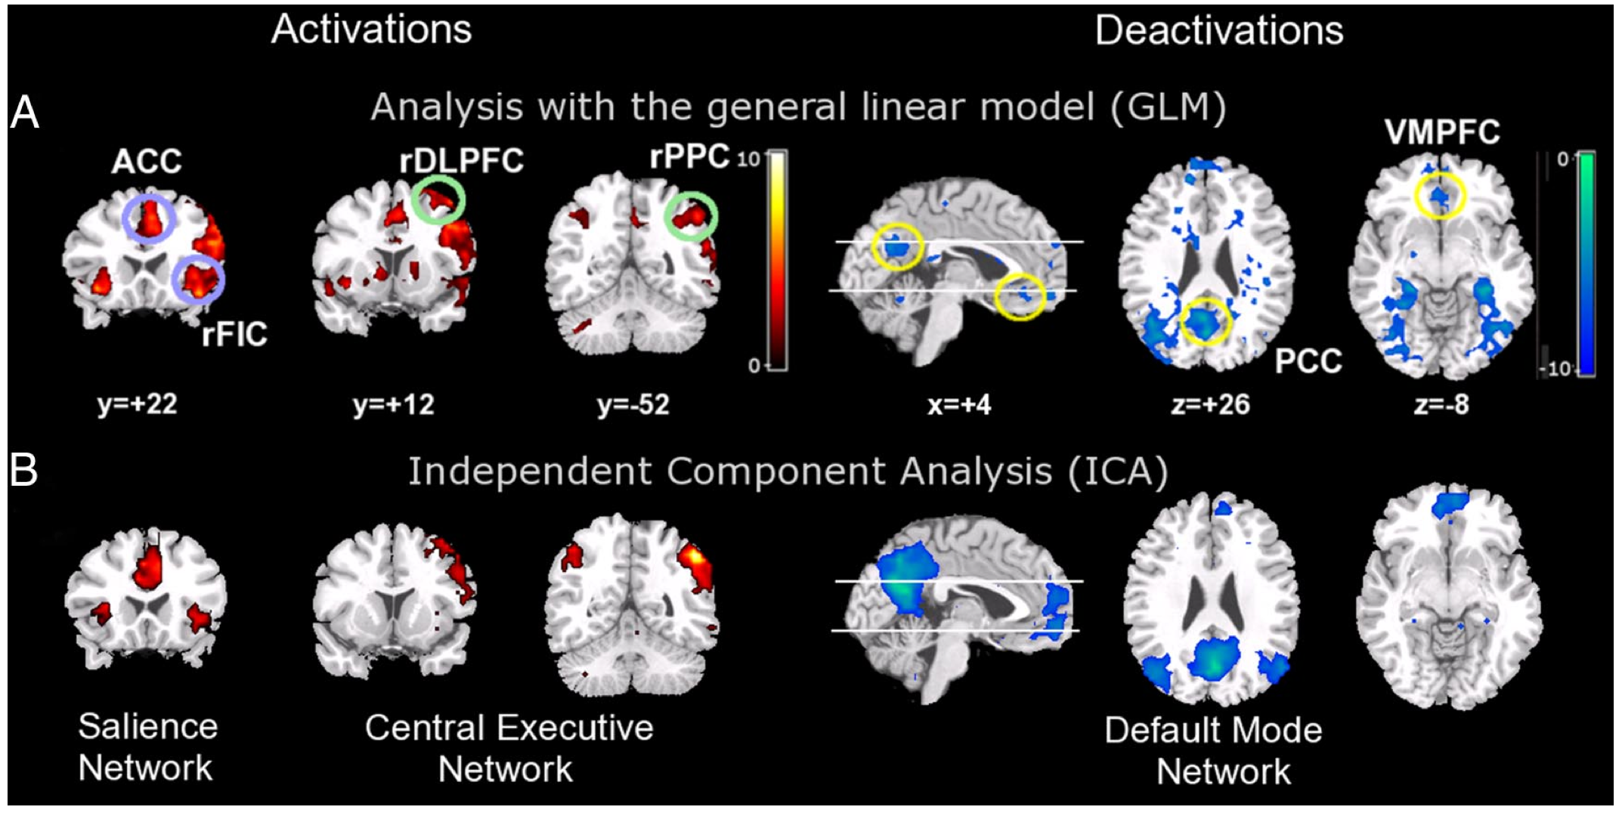
Introduction 2/3
Sridharan et al., 2008 PNAS
Notes:
- Analysis of resting-state functional connectivity, using both model-baed and model-free approaches, has suggested the existence of at least three canonical networks:
(i) a central- executive network (CEN), whose key nodes include the dorso- lateral prefrontal cortex (DLPFC), and posterior parietal cortex (PPC)
(ii) the default-mode network (DMN), which includes the ventromedial prefrontal cortex (VMPFC) and posterior cingu- late cortex (PCC)
(iii) a salience network (SN), which includes the ventrolateral prefrontal cortex (VLPFC) and an- terior insula (jointly referred to as the fronto-insular cortex; FIC) and the anterior cingulate cortex (ACC)
Granger causality analysis (GCA) of the six key nodes of the Salience (blue nodes), Central-Executive (green nodes) and Default-Mode (yellow nodes) networks during (A) auditory event segmentation, (B) visual oddball attention task, and (C) task-free resting state.
the thickness of the connecting arrows between two regions corresponds to the strength of directed connection
Punchlines:
1)This is true in task-free and task-constrained brain states.
2) Our analysis indicates that the rFIC, a key node of the SN, plays a critical and causal role in switching between the CEN and the DMN. The striking sim- ilarity of significant causal outflow from the rFIC across tasks, involving different stimulus modalities, indicates a general role for the rFIC in switching between two key brain networks.

Slide 7
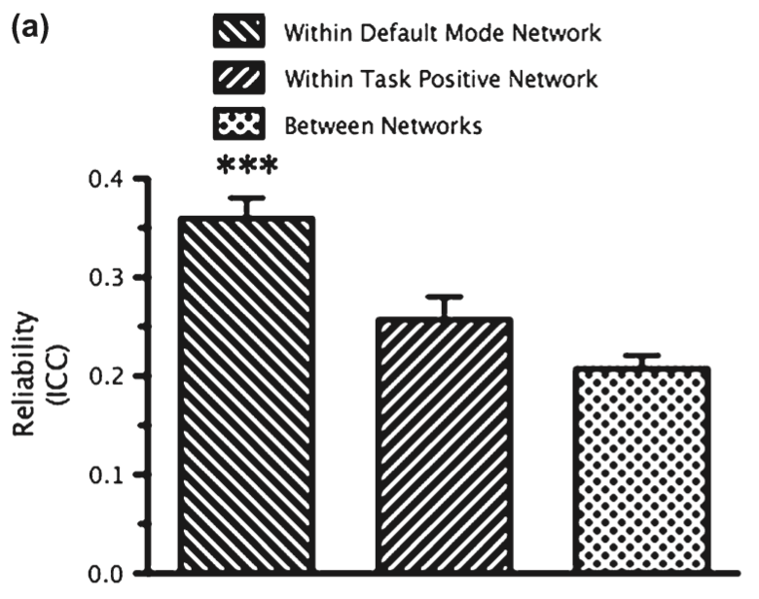
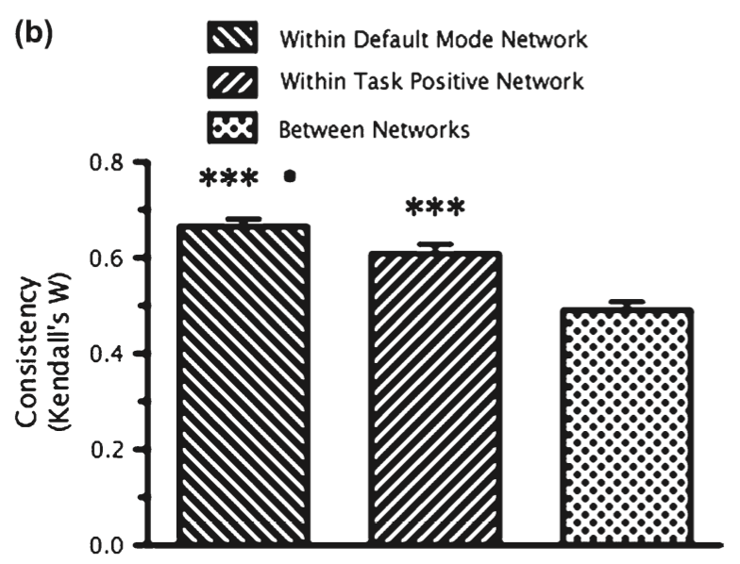
Introduction 3/3
Shehzad et al., 2009 Cereb Cortex
Notes:
Despite initial criticicsm, RSFC is actually pretty stable…
- Resting-state fluctuations \textit{between large-scale networks} were observed to be less stable
than coupling between regions of each network when assessed by intra-class correlation
- Between-network connections were also less stable than intra-network connections when
assessed by Kendall's coefficient of concordance
- Consequently, during task-unrelated random thought, network-network dynamics appear to be more volatile,
across participants and scans, than intra-network dynamics. This suggests network-network relationships as an under-appreciated unit of functional brain organization.
-> Explain why ICA and correlation do not solve the problem.

Slide 8
Workflow
Notes:
Let me quickly walk you through the pipeline…
Fill apparent whole in neuroscientists toolbox…
From a neurobiological perspective, we have the intuition that…
signaure: composition of the large-scale network during a given mental operations

Slide 9
Workflow: Example
cf. Bzdok et al., 2012 Cereb Cortex
Notes:
in line with purely experimental.

Slide 10
Sufficiency of network information
Notes:
If we only know how much each network is involved in the task, without having any direct access to voxel-wise activity in the brain.

Slide 11
Task versus rest network architecture
Notes:
reassuring face validity
-> models do not capture arbitrary features, but they show generalization properties

Slide 12
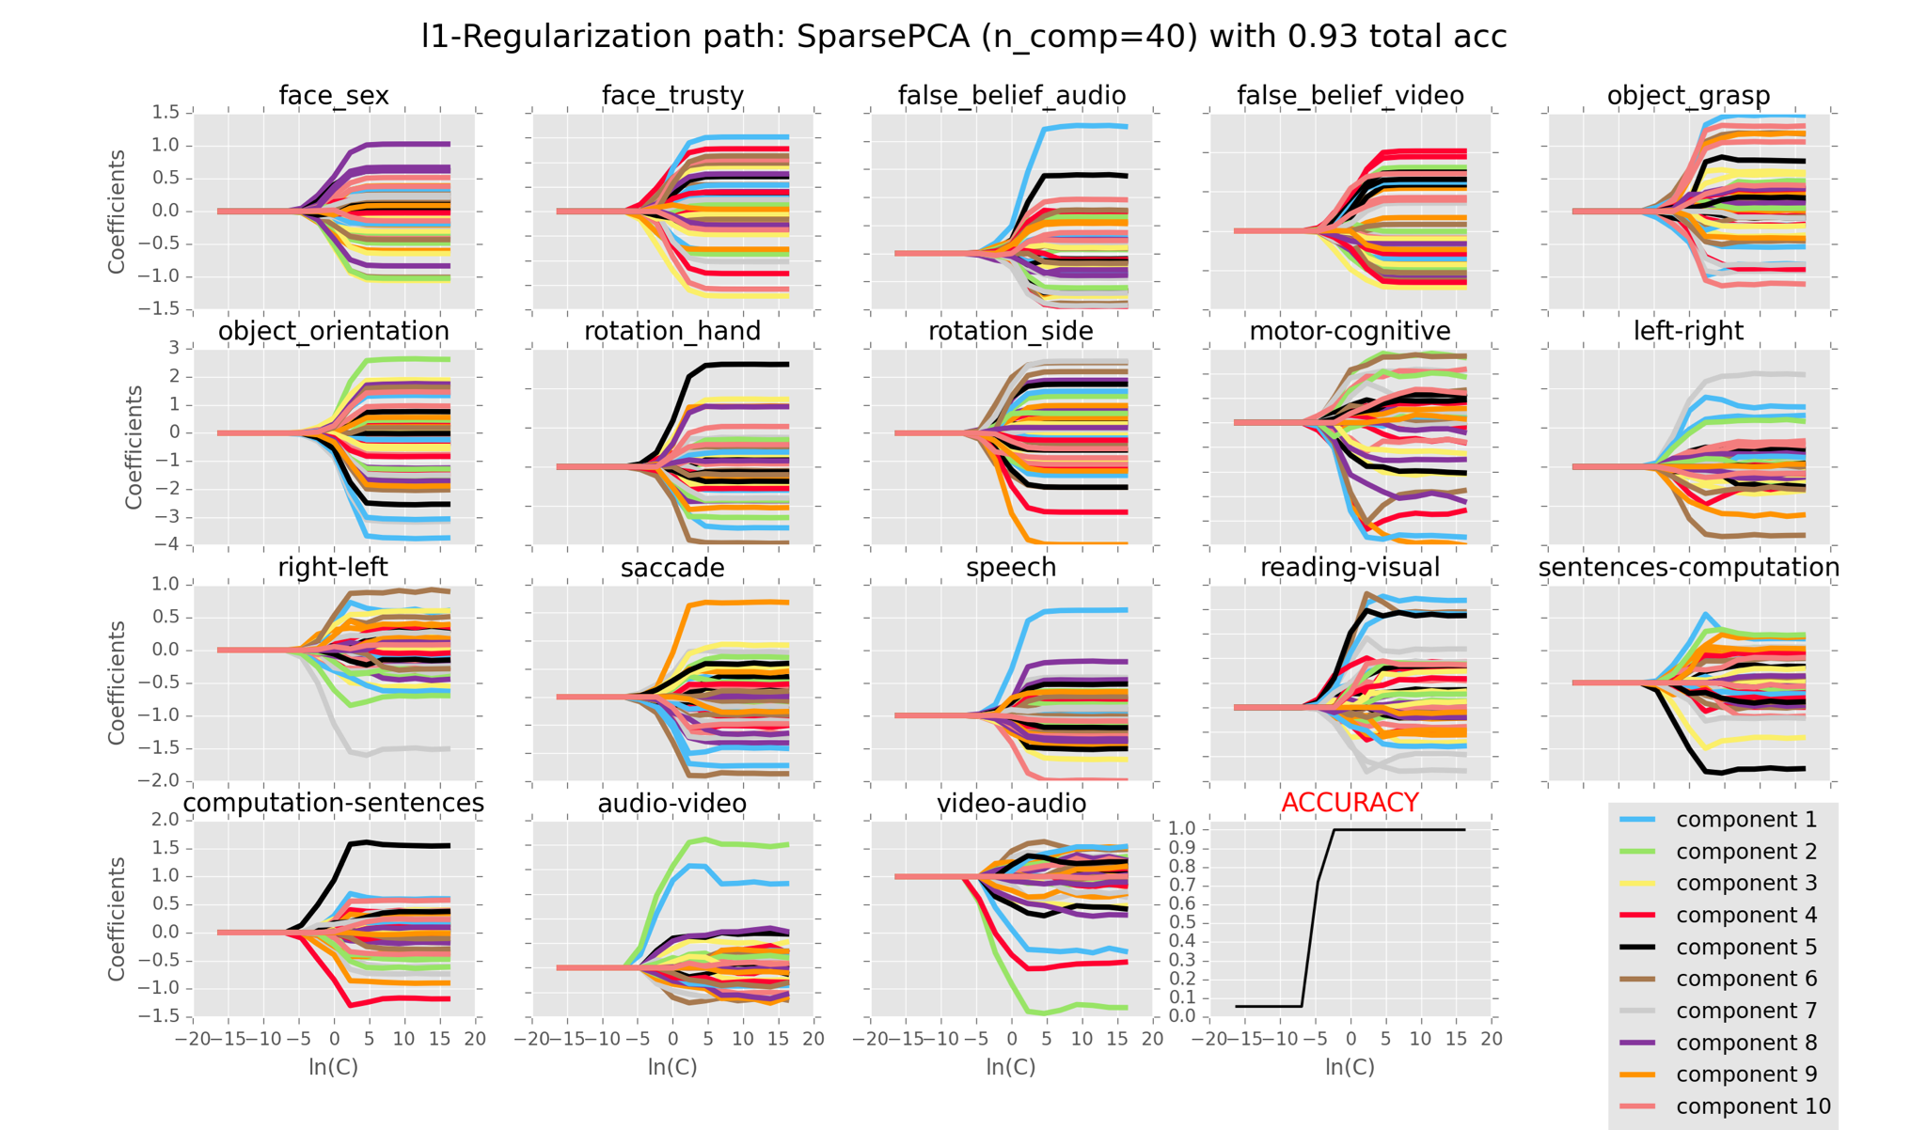
Regularization paths
Notes:
line: network implication

Slide 13
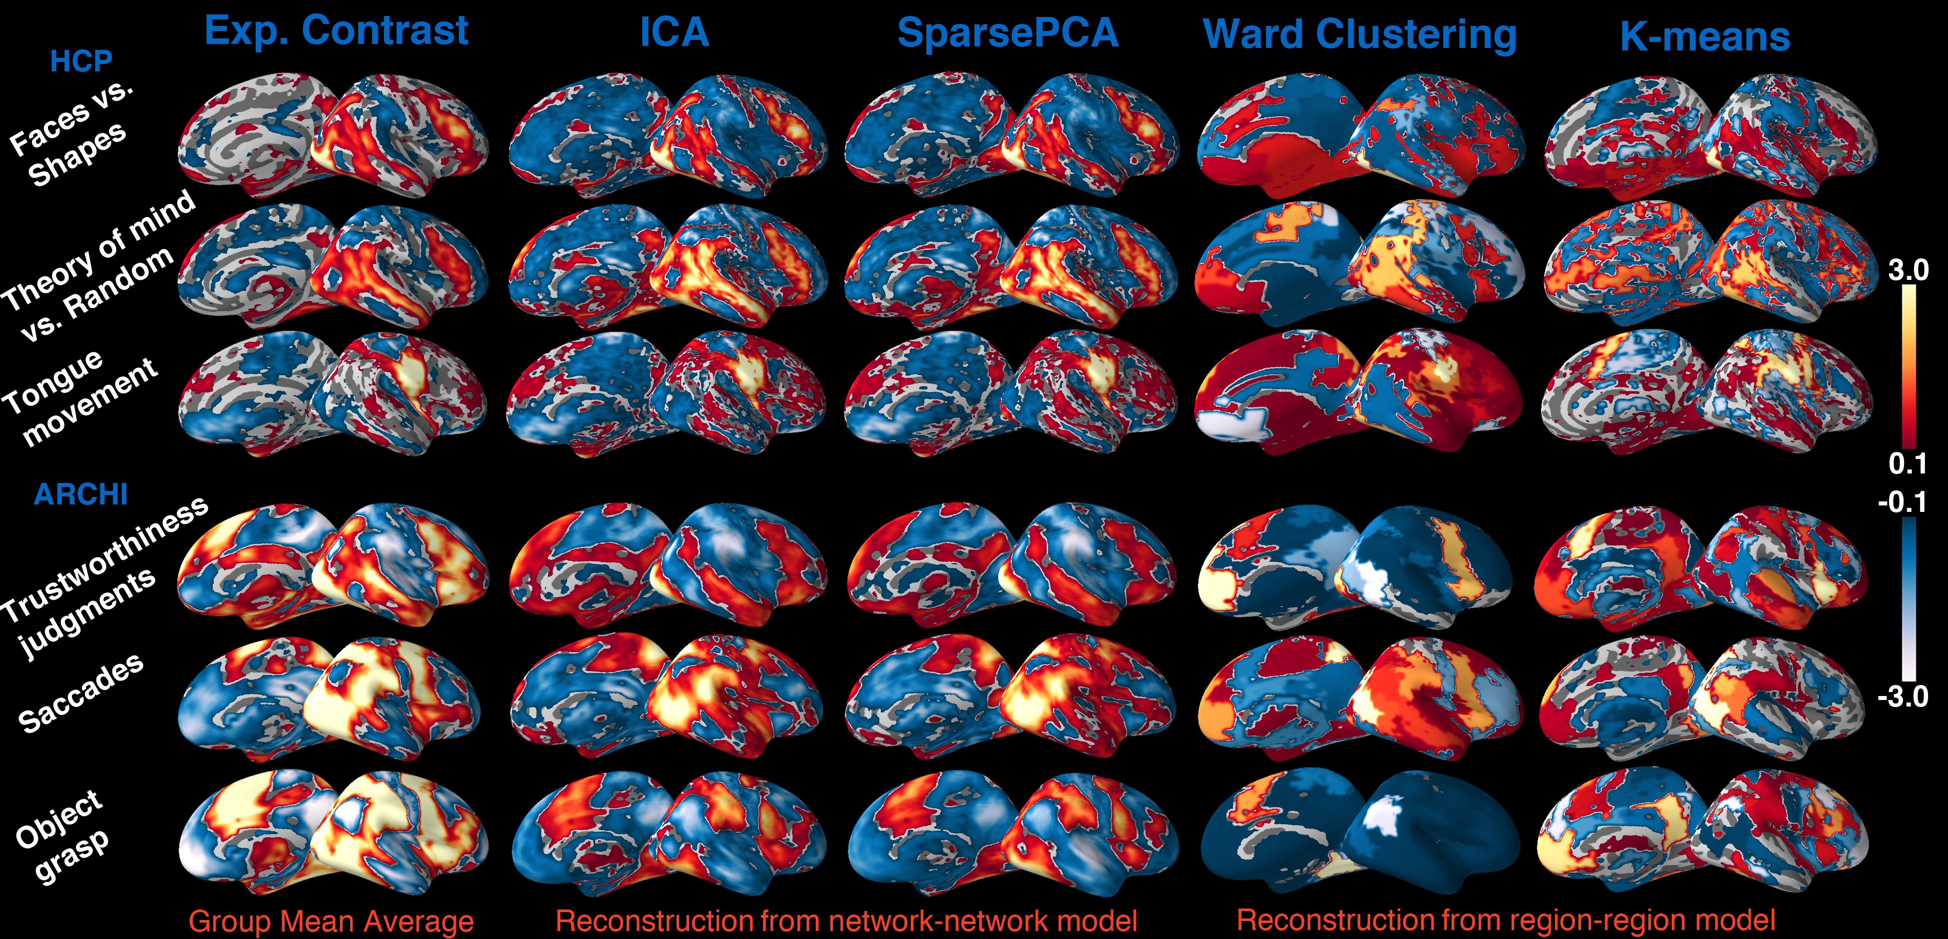
Network-network models versus region-region models
Notes:
What is better: If we divide the brain into overlapping networks and observe those?
Or if we divide the brain into non-overlapping regions and observe those?
-> Choosing between functional integration and functional specialization in fMRI interpretation, integration might be more important.
„You might be on the safer side if you go for integration.“

Slide 14
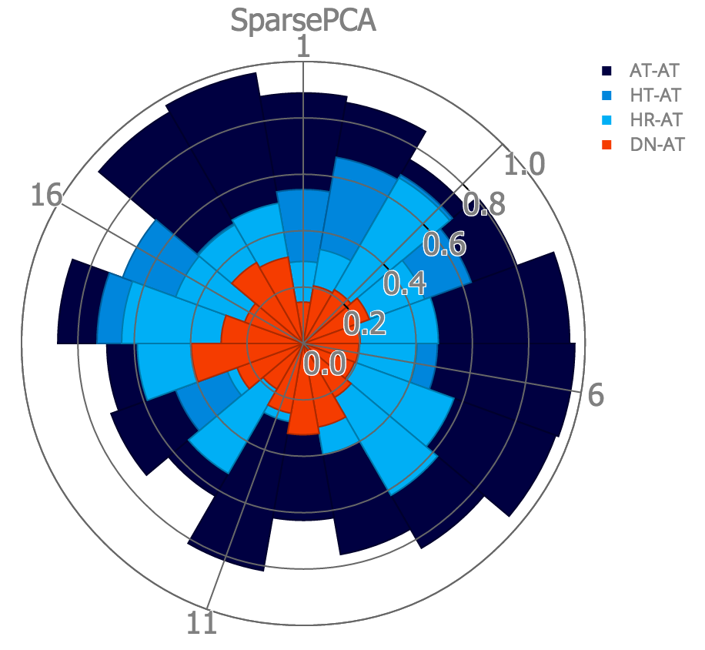
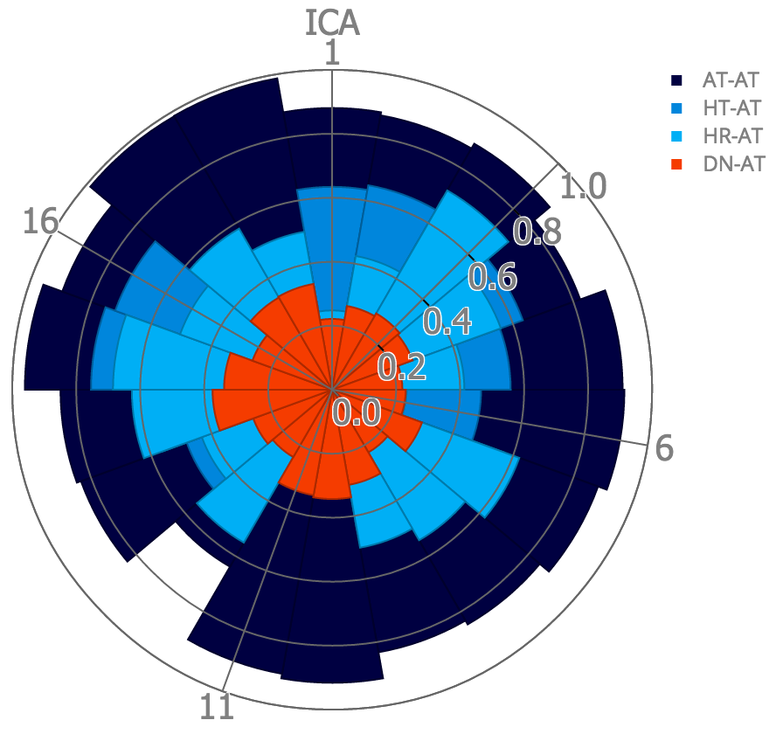
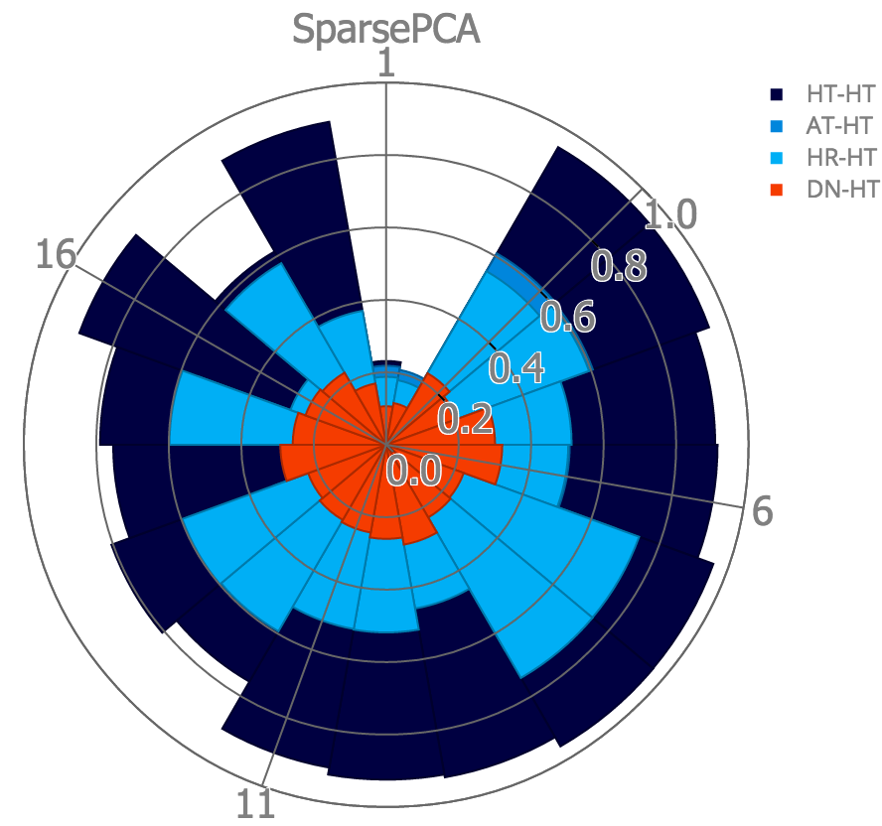
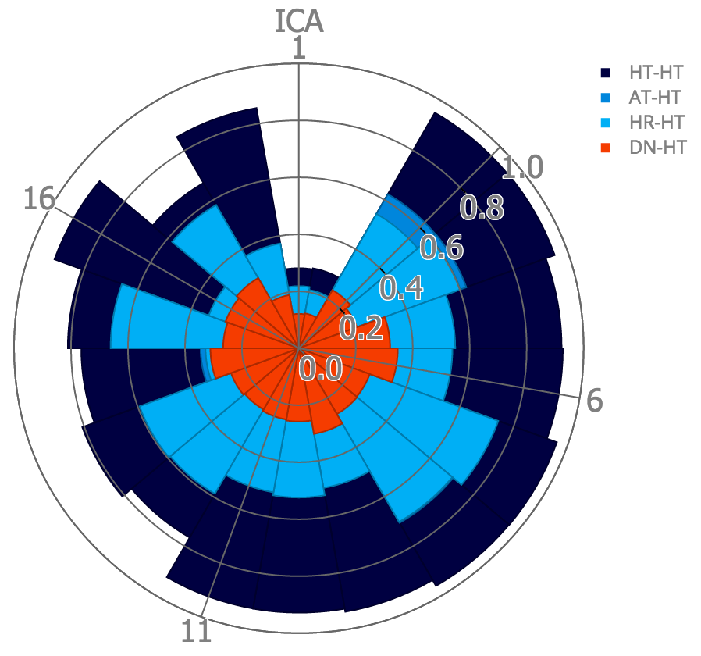
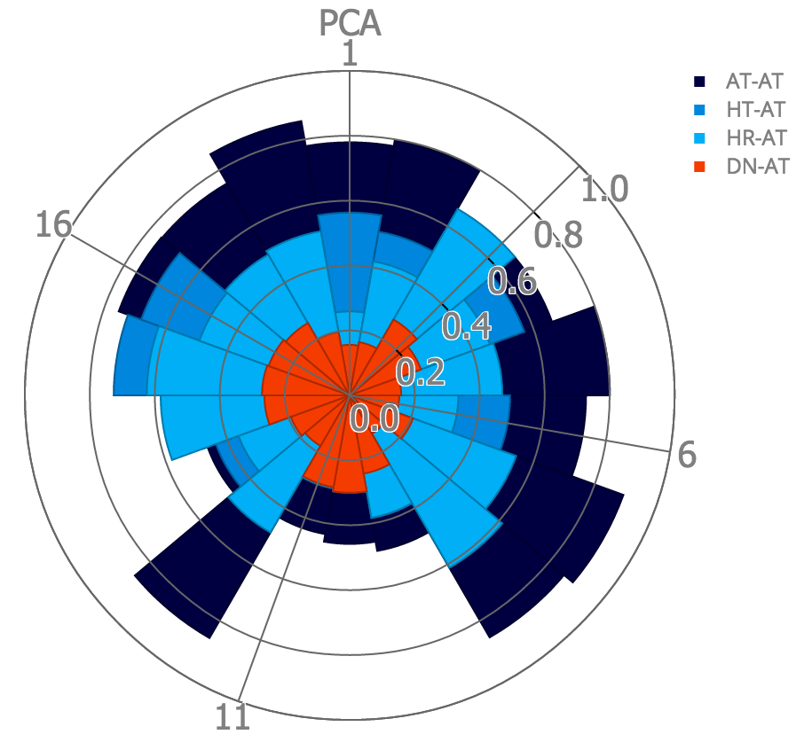
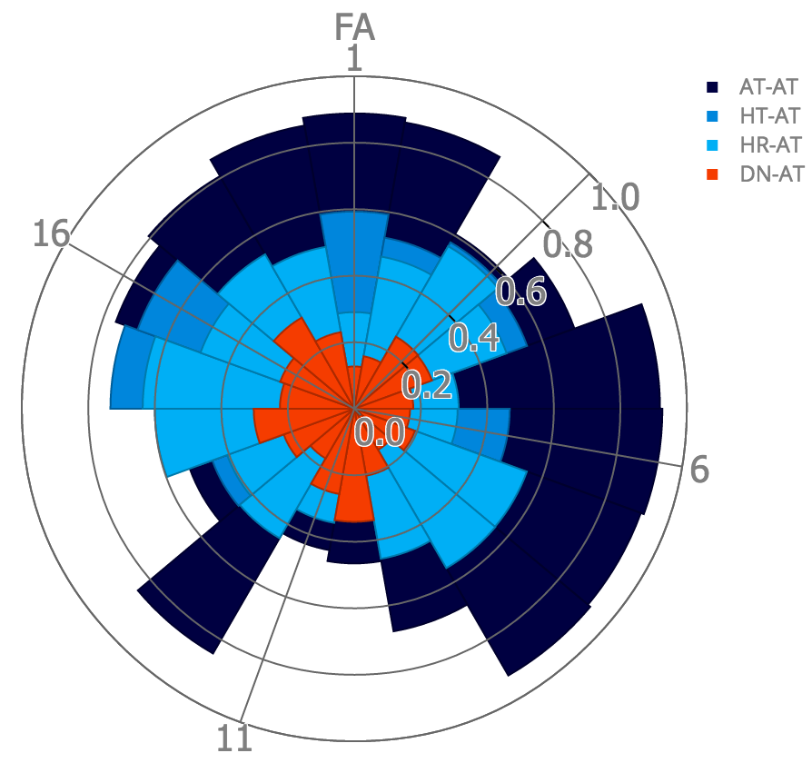
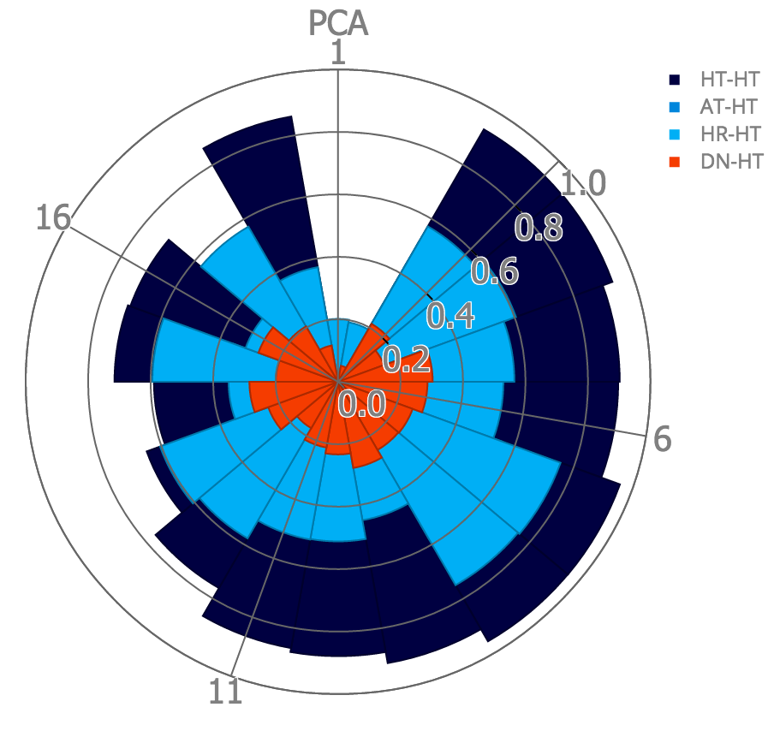
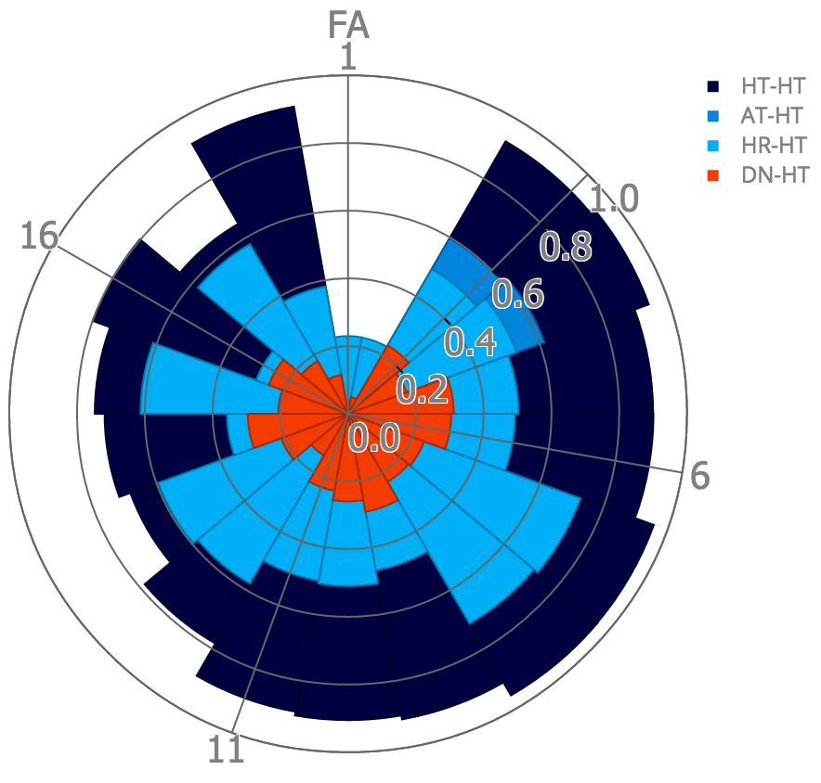
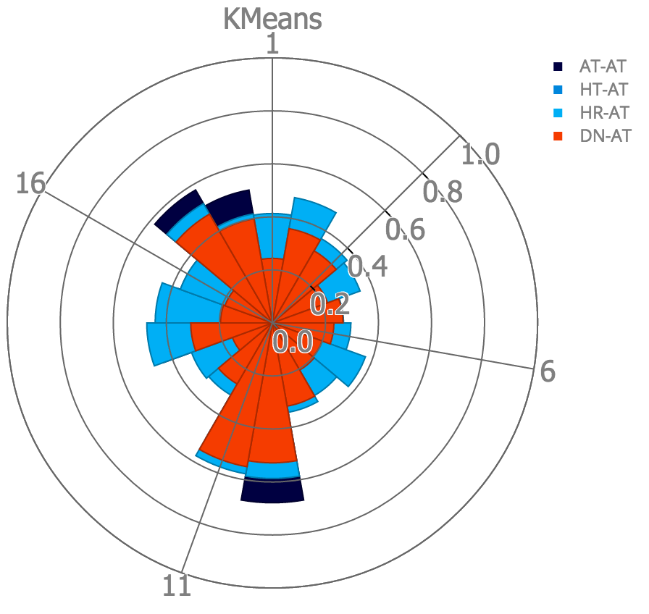
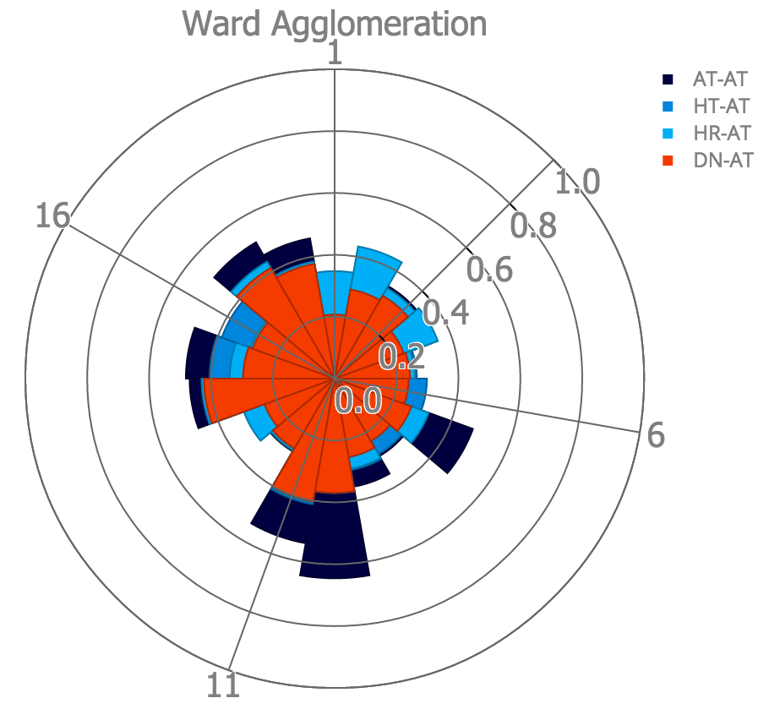
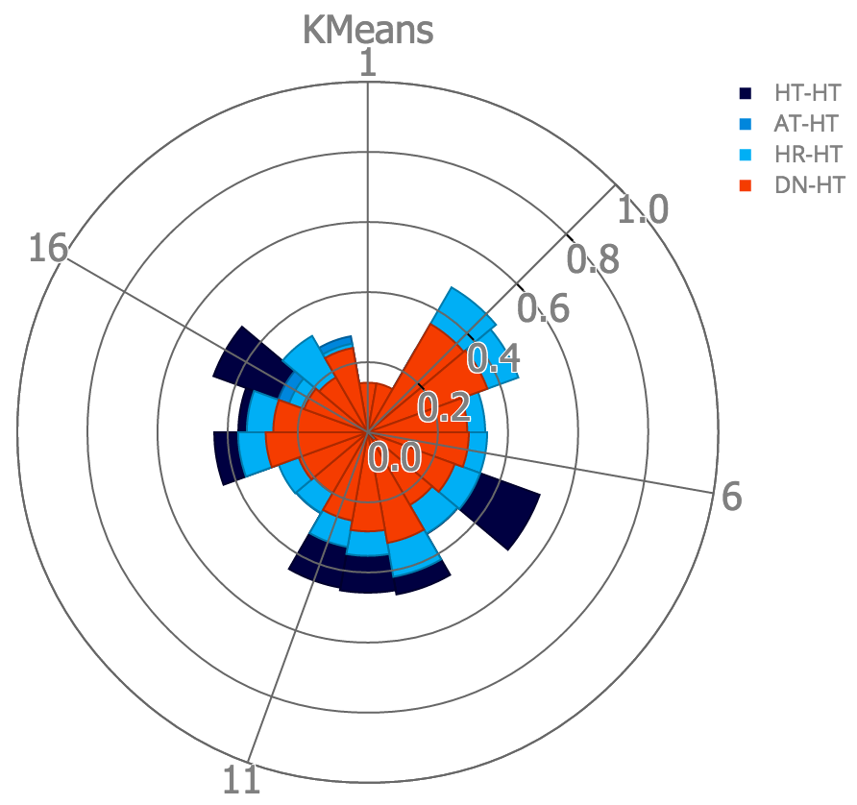
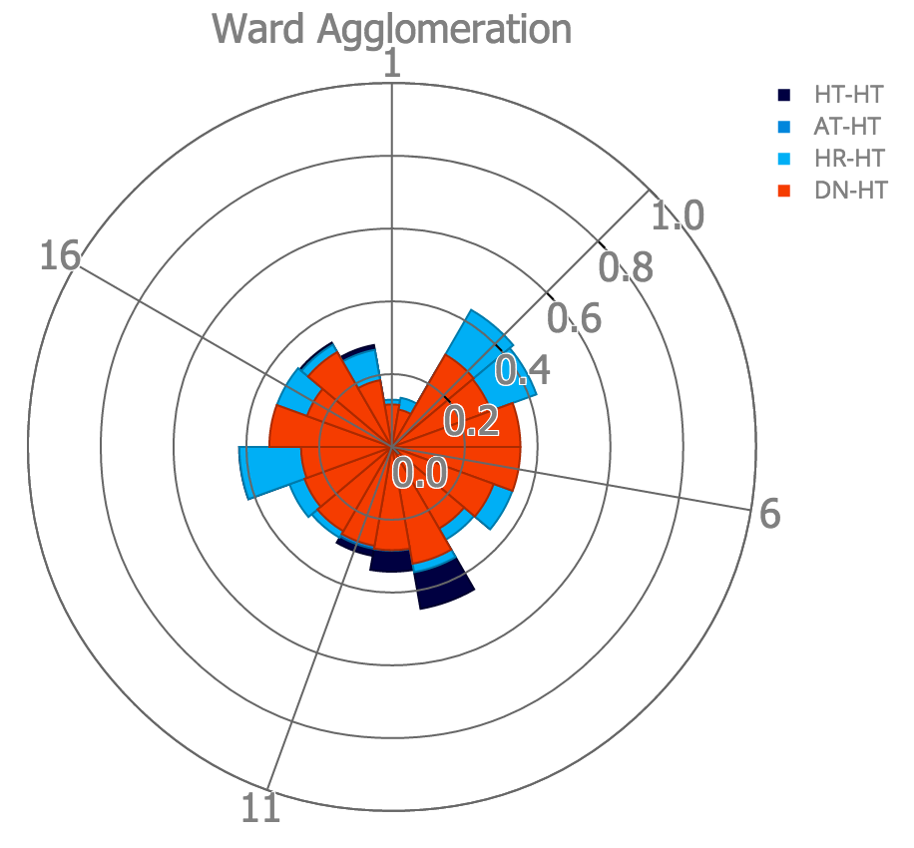
Task versus rest network architecture
ARCHI dataset
HCP dataset
Sparse PCA
ICA
Sparse PCA
ICA
Recovery
Recovery
ARCHI tasks
HCP tasks
PCA
FA
PCA
FA
K-means
Ward
K-means
Ward
ARCHI/task - ARCHI/task
HCP/task - ARCHI/task
HCP/rest - ARCHI/task
Noise - ARCHI/task
HCP/task - HCP/task
ARCHI/task - HCP/task
HCP/rest - HCP/task
Noise - HCP/task
Notes:
Conclusio:
a) fMRI activity can be explained by changes in network units
b) we can quantify and predict
c) new access to neural correlates of cognitive processes

Slide 15



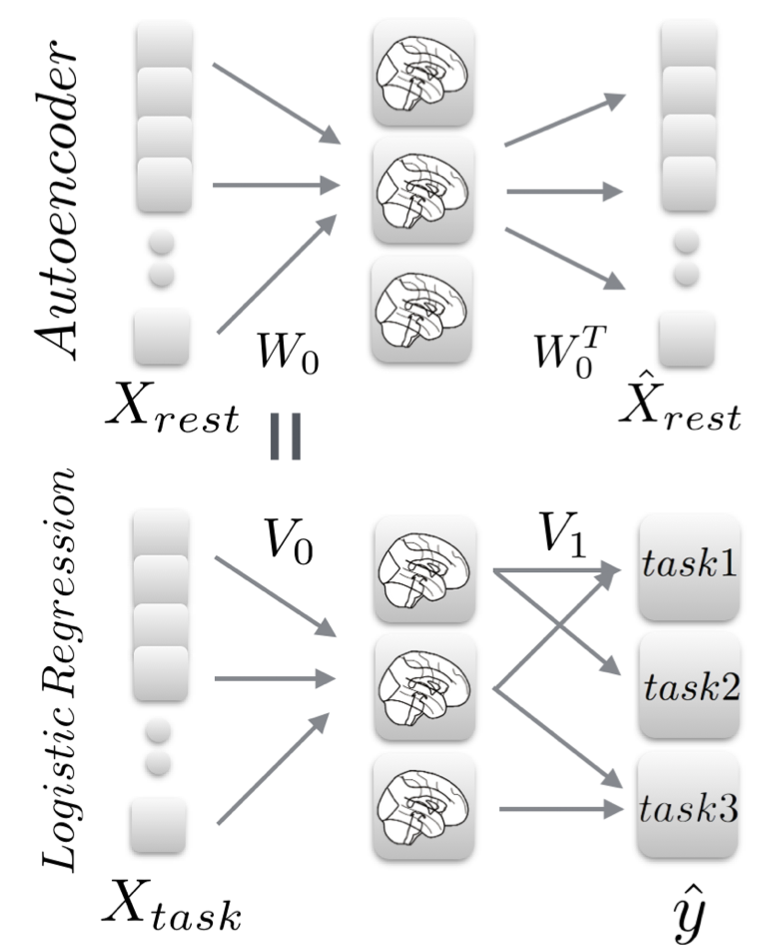
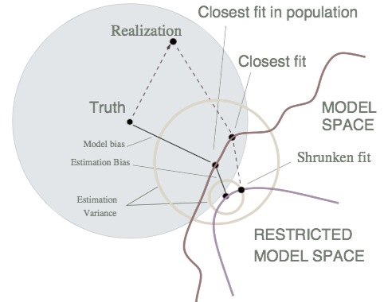
New machine-learning methods
Bzdok et al., 2015 NIPS
Notes:
The ever-increasing size of modern data sets combined with the difficulty of ob- taining label information has made semi-supervised learning one of the problems of significant practical importance in modern data analysis.

Slide 16
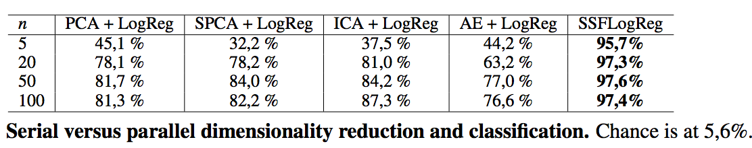
New machine-learning methods
Bzdok et al., 2015 NIPS
Notes:
The model performs better

Slide 17
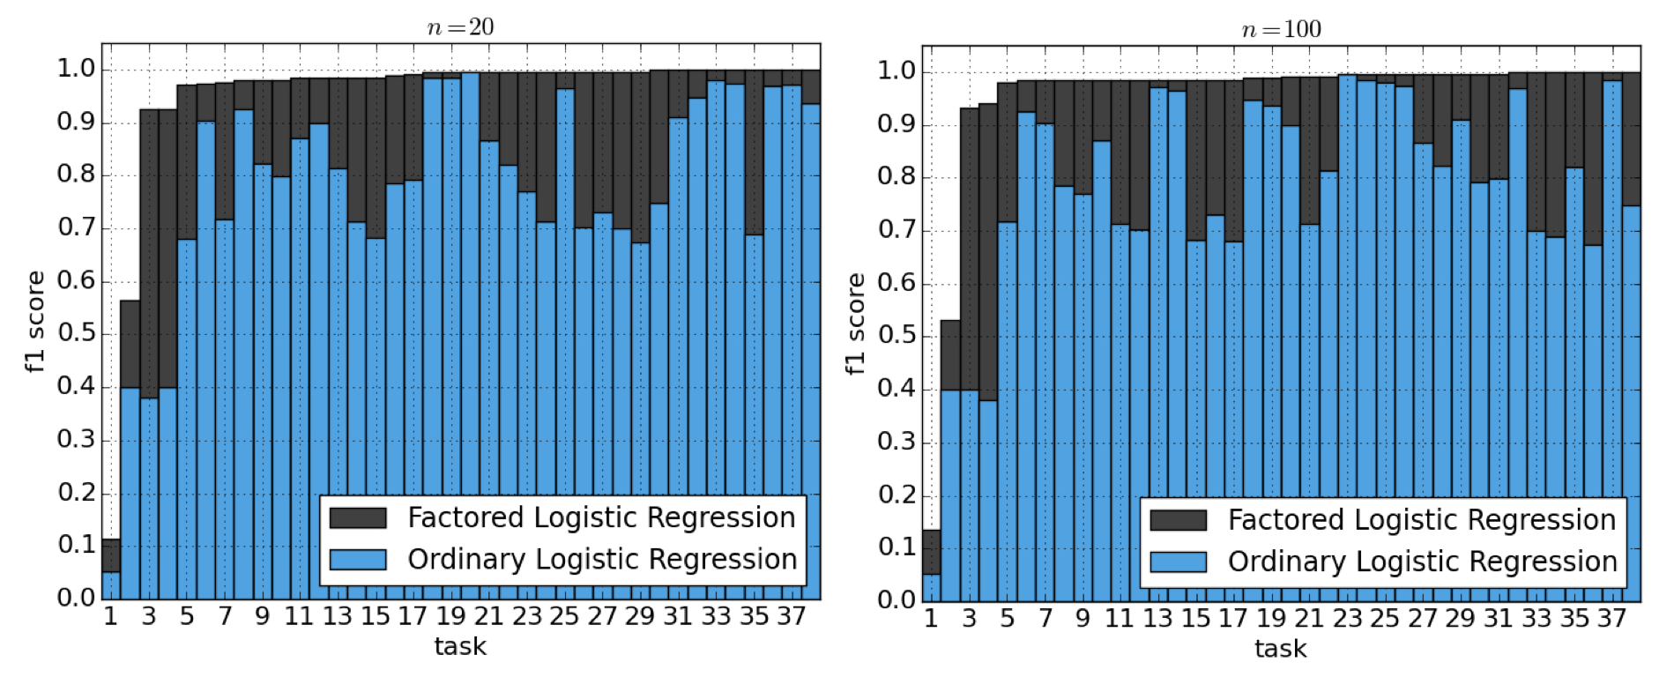
New machine-learning methods
Bzdok et al., 2015 NIPS
Notes:
Brain function in experimental paradigms.
Just reanalyze existing data.

Slide 18
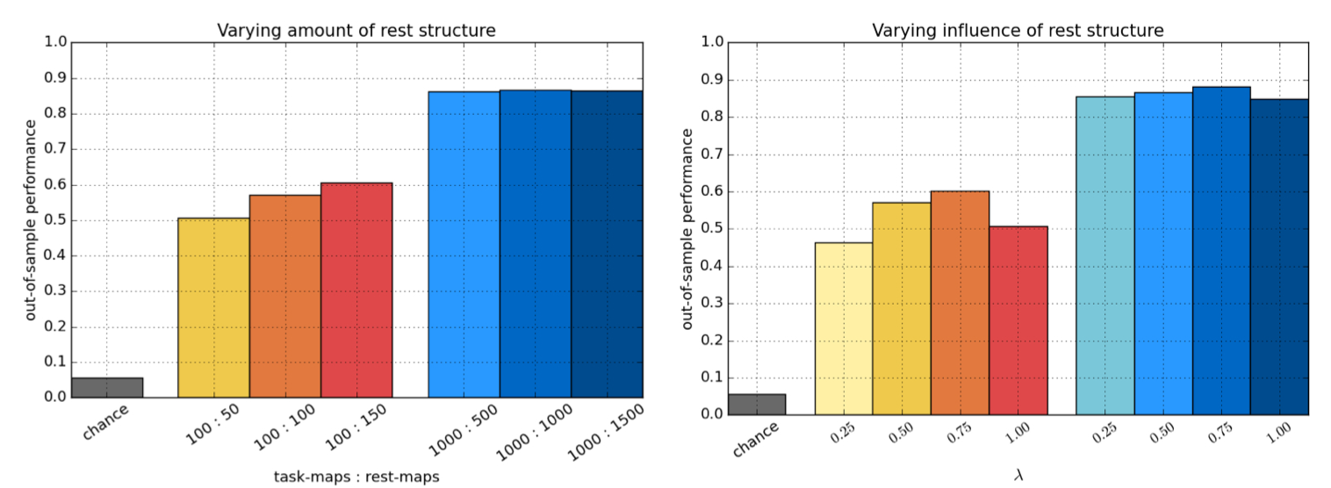
New machine-learning methods
Bzdok et al., 2015 NIPS
Notes:
Brain structure.

Slide 19
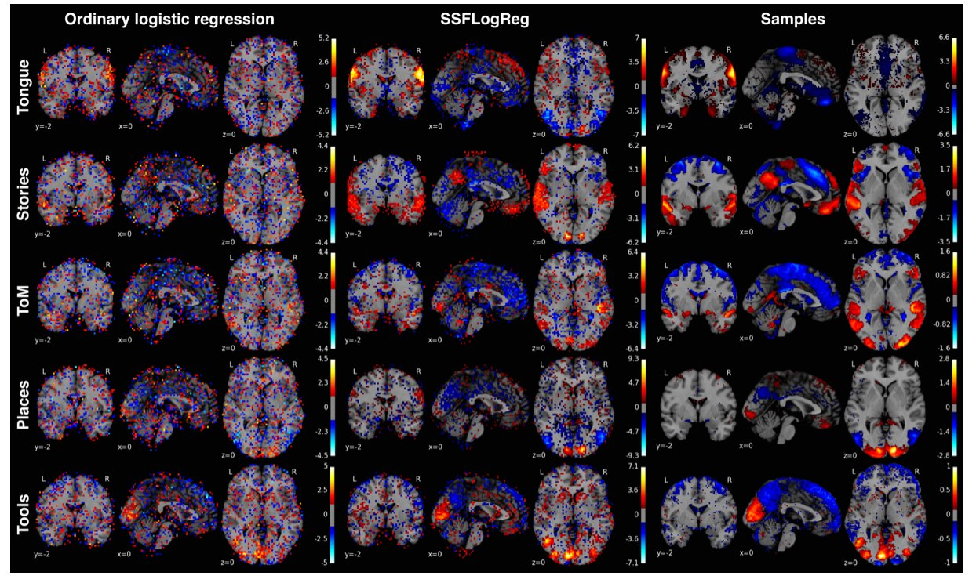
New machine-learning methods
Bzdok et al., 2015 NIPS
Notes:
The model is more interpretable!
Plain-vanilla…state-of-the-art…off-the-shelf…

Slide 20
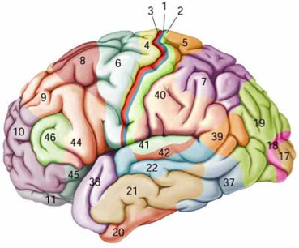
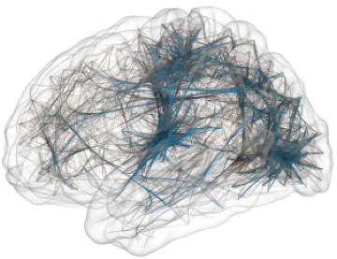
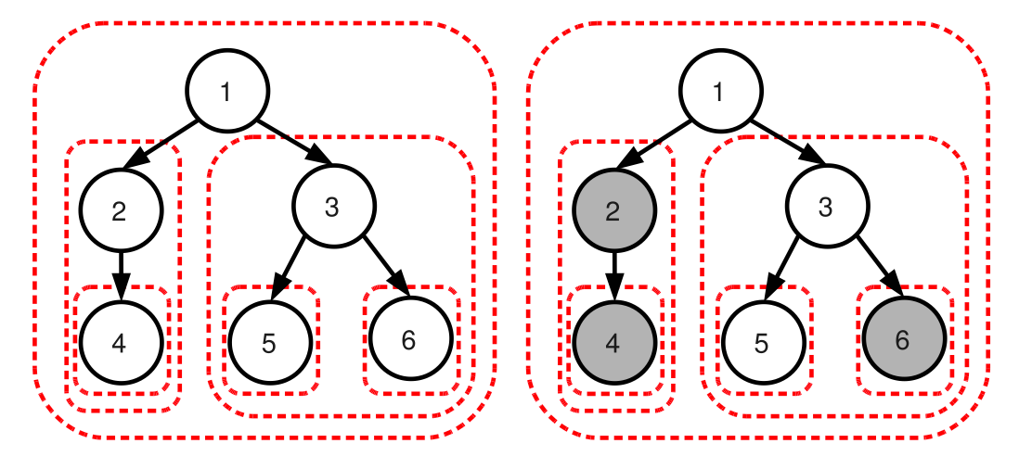
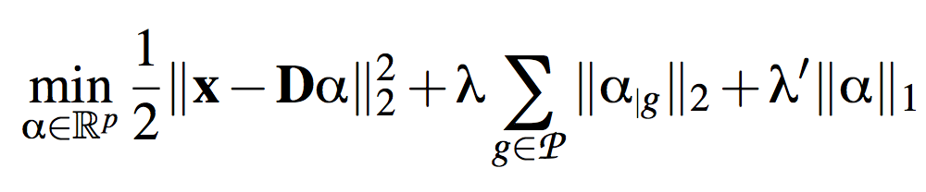
Outlook: Hierarchical Structured Sparsity
Jenatton et al., 2011 JMLR
Notes:
This sparsity pattern obeys the following equivalent rules: (i) if a node is selected, the same goes for all its ancestors. (ii) if a node is not selected, then its descendant are not selected.
From what I know, not many well curated implementation at the moment.

Slide 21
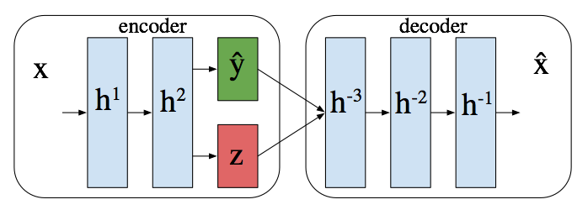
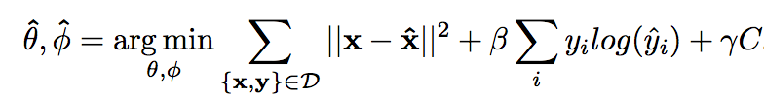
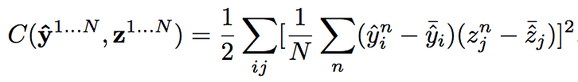
Outlook: Semi-supervised autoencoders
Cheung et al., 2015 ICML
Notes:
Brain connectivity.
NIlearn version of the SPM glass brain.
Successfully address the curse of dimensionality by…
Supervised algorithms approach this problem by learning features which transform the data into a space where different classes are linearly separable. However this often comes at the cost of discarding other variations such as style or pose that may be important for more general tasks.
class-irrelevant aspects
The first set (observed variables) is used in a discriminative task and during reconstruction. The second set (latent variables) is used only for reconstruction. To promote disentangling of representations in an autoencoder, we add two additional costs to the network. The first is a discriminative cost on the observed variables. The second is a novel cross-covariance penalty (XCov) between the observed and latent variables across a batch of data. This penalty prevents latent variables from encoding input variations due to class label. [17] proposed a similar penalty over terms in the product between the Jacobians of observed and latent variables with respect to the input. In our penalty, the variables which represent class assignment are separated from those which are encoding other factors of variations in the data.
Given an input x ∈ RD and its corresponding class label y ∈ RL for a dataset D, we consider the class label to be a high-level representation of its corresponding input.
The first term is a typical reconstruction cost (squared error) for an autoencoder. The second term is a standard supervised cost (cross-entropy).
For our experiments, we had categorical observed variables so we parametrized them as one-hot vectors and compute yˆ = softmax(Wyˆh2 + byˆ).
The XCov penalty to disentangle yˆ and z is simply a sum-squared cross-covariance penalty between ̄ ̄
the activations across samples in a batch of size N where yˆi and zˆj denote means over examples.
With the addition of a supervised cost and an unsupervised cross-covariance penalty, an autoen- coder can learn to disentangle various transformations using standard feedforward neural network
This has many potential applications in exploratory data analysis and signal denoising.

Slide 22
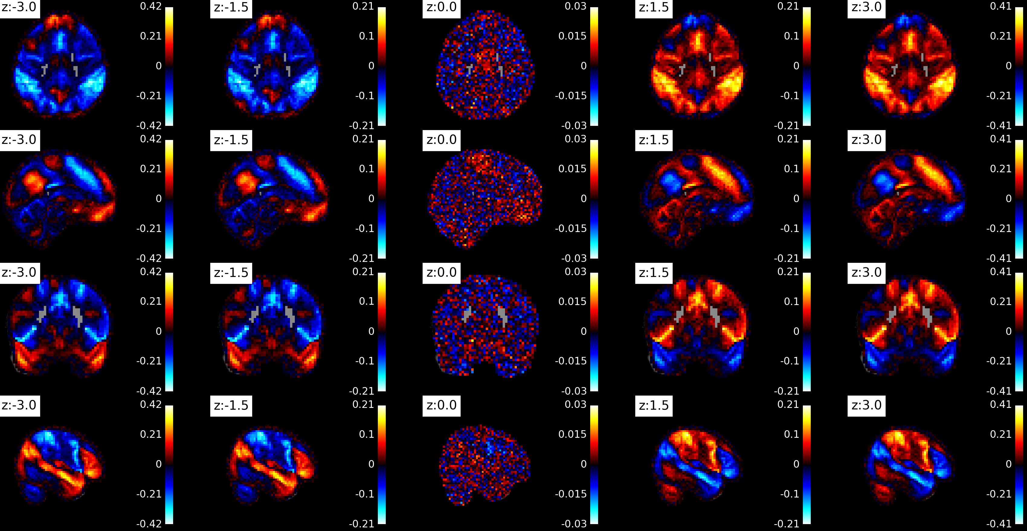
Outlook: Semi-supervised autoencoders
2D grid of two hidden variables in N-back task

Slide 23
Outlook: Semi-supervised autoencoders
Agreeableness
Openness
Conscientiousness
Neuroticism
Extraversion
Personality dimensions
Notes:
ols_n_latents2_n_hidden100_n_input79941_bs128_n_samples511_lr0.001000_l1=0.00_l2=0.10
Total validation-set accuracy: 0.89

Slide 24
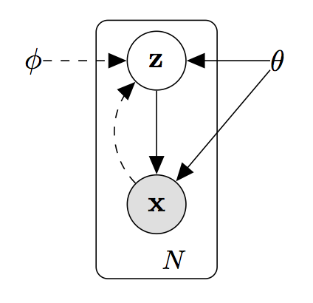
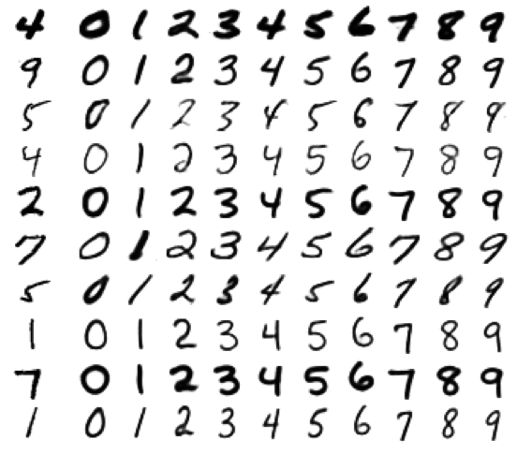
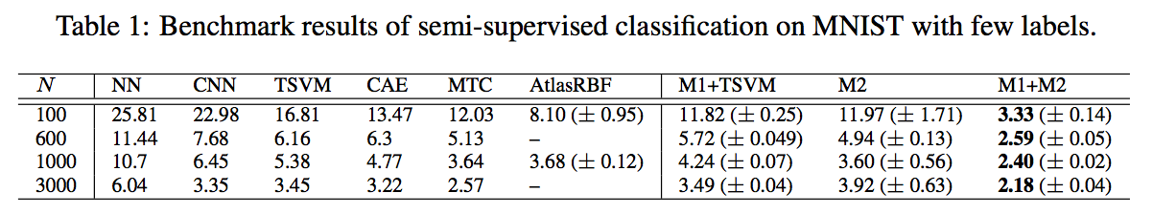
A deep generative neural network is learning experimental tasks
Kingma et al., 2014 NIPS
Notes:
The type of directed graphical model under consideration. Solid lines denote the generative model pθ(z)pθ(x|z), dashed lines denote the variational approximation qφ(z|x) to the intractable posterior pθ(z|x). The variational parameters φ are learned jointly with the generative model pa- rameters θ.
Figure: The leftmost columns show images from the test set. The other columns show analogical fantasies of x by the generative model, where the latent variable z of each row is set to the value inferred from the test-set image on the left by the inference network. Each column corresponds to a class label y.
How can we perform efficient inference and learning in directed probabilistic models, in the presence of continuous latent variables with intractable posterior distributions, and large datasets?
Bayesian methods tend not to scale to large datasets -> variational methods, besides expectation propagation, are remedies
posterior inference can be made espe- cially efficient by fitting an approximate inference model
Reparameterize the variational lower bound.
directed probabilistic models
the optimization of an approximation to the intractable posterior
yields a simple differentiable unbiased estimator of the lower bound
We want to differentiate and optimize the lower bound L(θ,φ;x(i)) w.r.t. both the variational
parameters φ and generative parameters θ.
The AEVB algorithm exposes a connection between directed probabilistic models (trained with a variational objective) and auto-encoders.
We show for the first time how variational inference can be brought to bear upon the prob- lem of semi-supervised classification.
joint optimisation of both model and variational param- eters, and that is scalable to large datasets.
50,000 training points between a labelled and unla- belled set, and varying the size of the labelled from 100 to 3000.

Slide 25
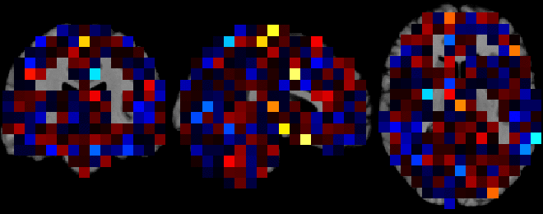
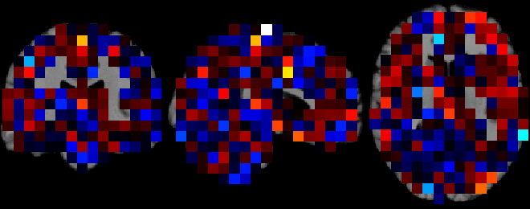
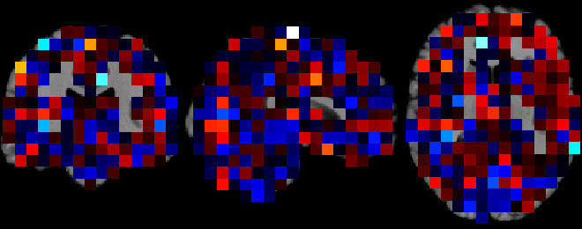
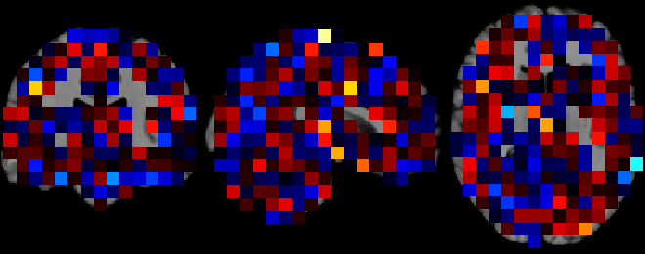
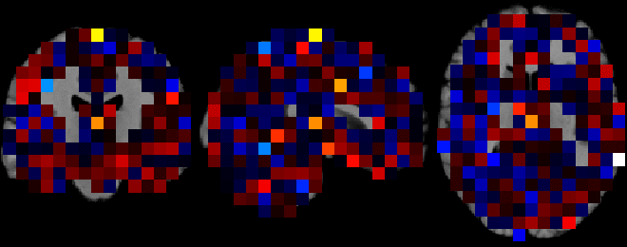
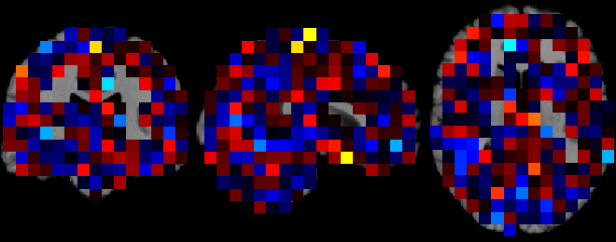
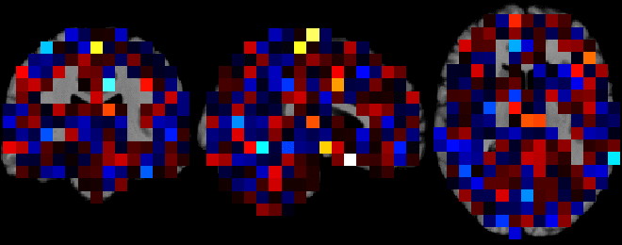
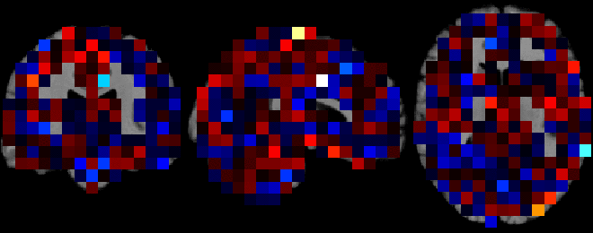
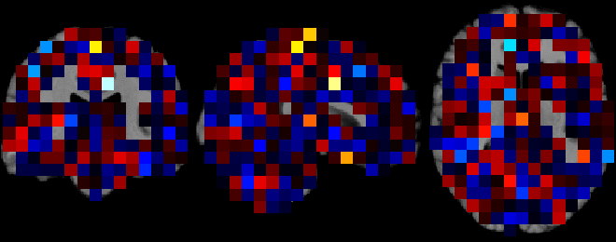
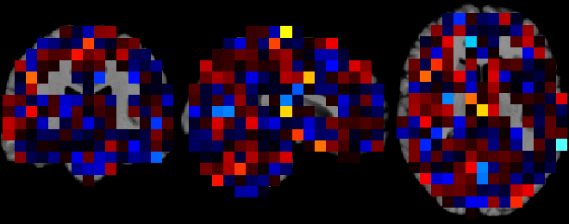









A deep generative neural network is learning experimental tasks
Reward
Punish
Shapes vs Faces
Faces vs Shapes
Random objects
Theory of mind
Math
Stories
Tongue movement
Food movement
Hand movement
Matching
Relations
Look at bodies
Look at faces
Look at places
Look at tools
Working memory
n=500 participants
Brain images are generated from inferred posterior distribution
Notes:
a single probabilistic model for all 18 classes
perhaps the first time that we have enough data

Slide 26


Outlook: Long-short term memory neural networks (LSTM)
Schmidhuber et al.
Notes:
LSTM is local in space and time; most common RNN variant with a more complicated network topology. The LSTM can decide to overwrite the memory cell, retrieve it, or keep it for the next time step.
LSTM generalizes RNNS -> RRNS generalize Hidden Markov models
LSTM can bridge arbitrary time lags between input events and target signals
It solves the vanishing gradients problem of RNNs (Hochreiter & Schmidhuber, 1997) by „an architecture enforcing constant (thus neither exploding or vanishing) error flow through internal states"
MOTIV
What is gonna happen next given what has already happened?
- generalizes well, despite the existing problems
- no need for parameter tuning (Hochreiter 97)
- bridge very long time lags by constant error back propagation within memory cells
- in „long-time-lag“ problems, LSTM can handle noise, distributed representation and continuous values
- does not require an a priori choice of a finite number of states, in contrast to finite state automata or HMMs
- can deal with an unlimited number of states, in principle
builds generative models for sequences (sequential generative model), a system with more introspective control; know the past to predict the future; „back propagation through time“, „powerful dynamical systems“;
capable of instantiating almost arbitrary dynamics

Slide 27

Outlook: Long-short term memory neural networks (LSTM)
Bromley et al., 1993
Notes:
Siamese networks
DEF Neural networks researchers think of such models as a network with
two identical copies of the same function, with the same weights, fed into a
“distance measuring” layer to compute whether the two examples are similar or
not, given labeled data.
- we do not need to know the categories in advance
Under this setting, discriminative tasks can be performed using weakly labelled data.
- can be an instance of weakly supervised learning
- Because the same func- tion with the same parameters is used to process both inputs, the similarity metric is symmetric. This is called a siamese architecture
- paramter vector is shared !!
- „genuine pair“ versus „impostor pair“
- The method is best suited for classification or verification scenarios where the num- ber of classes is very large, and/or where examples of all the classes are not available at the time of training.

Slide 28


Partners
Supporters
Prof. Simon Eickhoff – Jülich
Prof. Karl Zilles – Jülich
Prof. Alexandre Gramfort – Paris
Dr. Denis Engemann – Paris
Prof. Bertrand Thirion – Paris
Prof. Gaël Varoquaux – Paris
PD. Leonhard Schilbach – Munich
Prof. Peter Fox – San Antonio
Prof. Angela Laird – Miami
Prof. David Sanders – Genf
Prof. Gesa Hartwigsen – Leipzig
Prof. Jorge Moll – Rio de Janeiro
BZ 2/2-1
BZ 2/3-1
Notes:
Brain connectivity.
NIlearn version of the SPM glass brain.
Successfully address the curse of dimensionality by…

Slide 29






Notes:
Please excuse some „product placement“ at the end
Parietal group at Neurospin in Paris.
traditionelle Softwarelösungen (SPM und auch FSL) stoßen an Grenzen
hoch-dimensionale Bildgebungs-Datensätze
BigData-fähige Ecosystems

