Slide 1
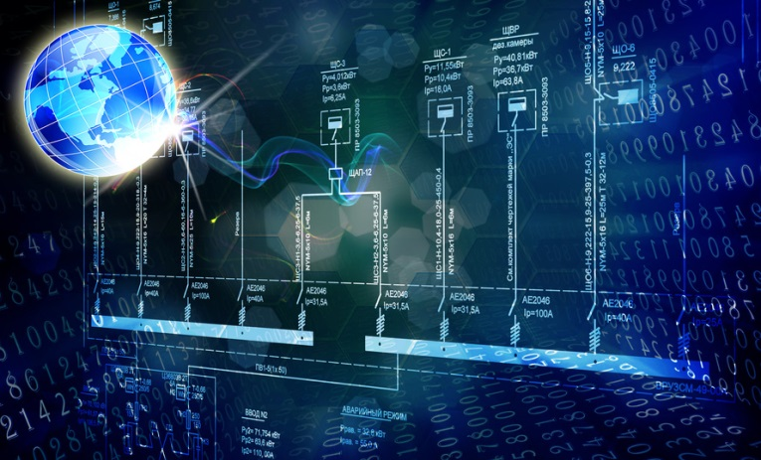
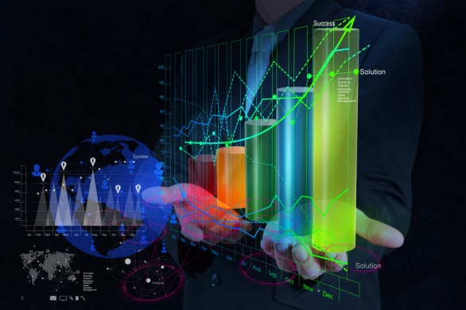
Data Science at the Institute Cluster IMA/ZLW & IfU Data Science projects in research and industrial applications
Data Science: Theory and Application
RWTH Aachen University - ICT Cubes
October 26, 2015
Dr.-Ing. Dipl.-Inform. Daniel Ewert
Prof. Dr.-Ing. Tobias Meisen
Dr.-Ing. Dipl.-Inform. Christian Tummel
IMA/ZLW & IfU
Fakultät für Maschinenwesen
RWTH Aachen University

Slide 2
Agenda
Institute cluster IMA/ZLW & IfU
Who we are and what we do - a very short introduction
Data Science in Research and Industrial Applications
Short description of selected ”data science” projects that we are currently executing at our institute cluster
Automatic Emotion Recognition
Social Media Analysis
Predictive Analytics in High Pressure Die Casting
Comparison of huge list structures
Gameplay Analysis of RoboCup Logistics League
Summary

Slide 3
Institute Cluster
IMA/ZLW & IfU

Slide 4
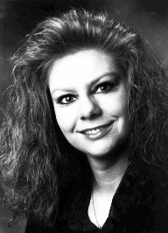
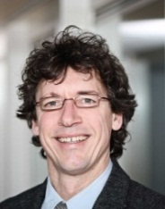
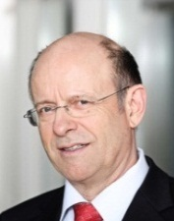
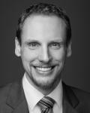
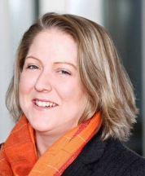
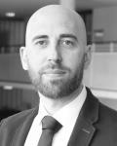
Institute Cluster IMA/ZLW & IfU
Organisational Chart
_{Prof. Dr. rer. nat.} _{Sabina Jeschke}
_{Head of Institute}
_{apl.-Prof. Dr. habil.} _{Ingrid Isenhardt}
_{Deputy Head} _{of Institute}
_{Dr. rer. nat.} _{Frank Hees}
_{Vice Deputy Head} _{of Institute}
_{Prof. Dr.-Ing. em.} _{Klaus Henning}
_{Administration}
_{Senior Advisor}
_{IT & Media}
_{Technology}
_{IMA}
Institute of Information Management in Mechanical Engineering
_{Prof. Dr.-Ing.}
_{Tobias Meisen}
_{Managing Director}
_{Junior Professorship}
_{ZLW}
Center for Learning and Knowledge Management
_{Prof. Dr. phil.} _{Anja Richert}
_{Managing Director}
_{Junior Professorship}
_{IfU}
Associated Institute for Management Cybernetics
_{Dr. rer. nat.} _{René Vossen} _{Managing Director}
_{Public} _{Relations}
_{Traffic and Mobility} Dr. rer. nat. Philipp Meisen (temporary)
_{Production Technology} _{Dr.-Ing. Christian Büscher}
_{eHealth} _{Dr. rer. nat. Philipp Meisen}
_{Innovation Research &}
_{Futurology}
Prof. Dr. phil. Anja Richert (temporary)
_{Knowledge} _{Engineering} _{Dr. rer. pol. Claudia Jooß}
_{Didactics in STEM Fields}
_{Dr. phil Katharina Schuster}
Agile Mana-gement & eHumanities _{Dr.-Ing. Dipl.-Inform.} _{Christian} _{Tummel}
Economic and Social Cybernetics
_{Dr. phil. Kristina Lahl}
_{Engineering}
_{Cybernetics}
Dr.-Ing. Dipl.-Inform. Daniel Ewert

Slide 5
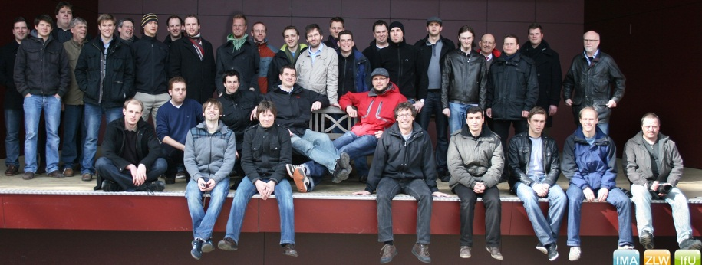
Institute Cluster IMA/ZLW & IfU Data and Facts
→
Located at the Faculty of Mechanical Engineering of the RWTH Aachen University
!
Cross-disciplinary teams work together on interdisciplinary projects
Team = ca. 214 employees
approx. 65 scientists
50 % from Engineering and Natural Sciences
50 % from Humanities and Economic Sciences
Gender-Mix: ca. 50:50
Culture-Mix: ca. 90:10
approx. 20 employees in service and administration
approx. 130 student workers
Financial structure in a nutshell
approx. 80 % third-party funding
approx. 6 million € annual turnover

Slide 6
Data Science in our perspective From Data to Decisions
“At the end of the day, it's not about how much data you have, it's about how well you use it.” Tjeerd Brenninkmeijer, CMSWire, 2013
Data
Smart
Data
Decision
detect, collect, capture, expatiate, network
consolidate,
restructure, model, verify, enrich, pre-evaluate
sort, rearrange, reproduce, reduce, densify, validate
visualize, interact, interpret, rank, analyze
Simulations
Sensors
Databases
Documentation
Applications
Extract Transform Load
Streaming
Descriptive Analysis
Metadata Enrichment
Semantic Integration
Predictive Analysis
Prescriptive Analysis
Data Mining
Data Exploration
Machine Learning
Visual Analytics
Key Performance Indicators
Cockpits and Reports
Mental Models
!
“Data about data, or metadata, is growing twice as fast as the digital universe as a whole” [Gantz and Reinsel 2011]

Slide 7
Data Science in
Research and
Industrial Applications

Slide 8
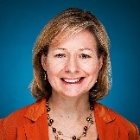
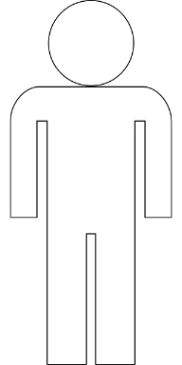
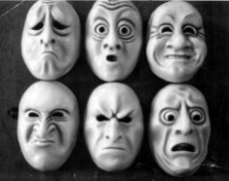
Automatic Emotion Recognition Motivation and Basic Idea
→
Motivation for the Development of Automatic Emotion Recognition
“Computers that will interact naturally and intelligently with humans need the ability to at least recognize and express affect.” [Rosalind Picard, 1997]
→
Basic Idea for the Process of Automatic Emotion Recognition
!
Emotions (e.g. fear, sadness or joy) are expressed in many ways by humans :
!
Use Machine Learning (ML) algorithms for recognition:
Facial Expression
Brain Activity
$$\left(\begin{aligned}x_{1} \\ x_{2} \\ … \\ x_{n}\end{aligned}\right)$$
Speech & Lang.
Heartbeat
ML
Gesture
Skin Resistance

Slide 9
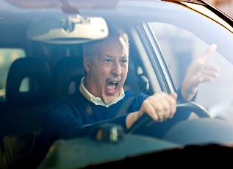
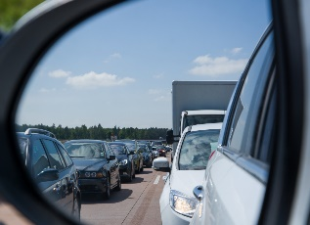
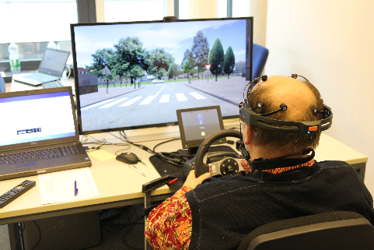
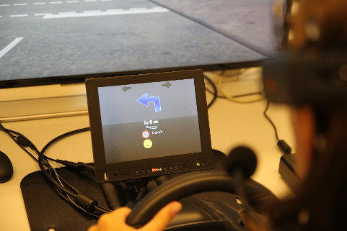
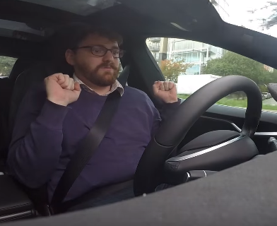
Automatic Emotion Recognition Use Cases
→
Applications for Emotion Recognition in the Automotive Sector
Anger and Stress are an integral part of modern road traffic. For instance, surely almost anybody was at one time unsatisfied with his/hers GPS and yelled at it …
→
Research Project IMOTION
→
Research Idea Autonomous Car
!
Prototypical development of an emotion adaptive GPS system
!
Feedback of the car to calm down the driver in ambiguous situations
“I think that was me getting nervous …” [Test driver of the Tesla Autopilot System, October 2015]

Slide 10
Social Media Analysis Sentiment Analysis for Social Media Content Analysis
!
„Sentiment analysis (also known as opinion mining) refers to the use of natural language processing, text analysis and computational linguistics to identify and extract subjective information in source materials. Sentiment analysis is widely applied to reviews and social media for a variety of applications, ranging from marketing to customer service. “
→
Sentiment Analysis of Social Media for Evaluating Universities
!
Focus: Twitter as the most famous microblogging Social Media Platform
!
Focus: Content that is in the context of education or related to universities
RWTH Aachen University
Karlsruher Institute for Technology
TU Braunschweig
TU Dresden
Leibniz Universität Hannover
TU Berlin
TU Darmstadt
Universität Stuttgart
TU München

Slide 11
Social Media Analysis Sentiment Analysis of Social Media for Evaluating Universities
→
Extract tweets that are related to the TU9 universities in Germany
!
Data collection and analysis
Data Collection
16488 Tweets
Winter Semester (Oct, 2014 / March, 2015)
German & English tweets
Data Processing
Classification to „Positive“ and „Not Positive“
Naive Bayes Supervised Classifier
4000 tweets as training set
Classifier Performance
Based on 1-gram and 2-grams features
73,3% of the tweets are guessed correctly

Slide 12
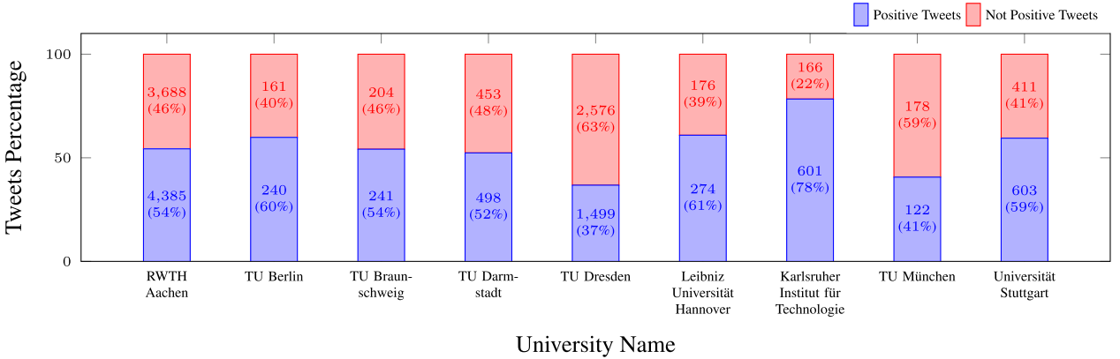
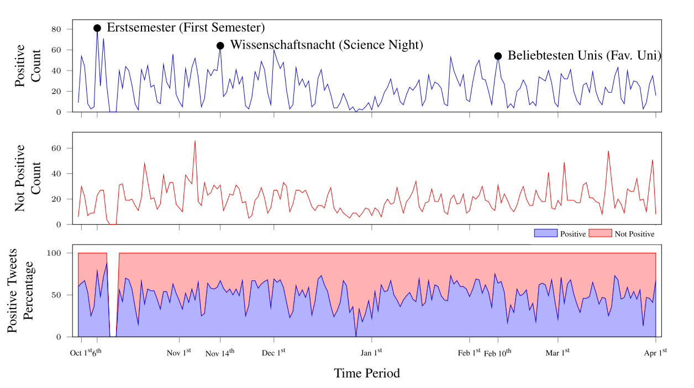
Social Media Analysis Social Media for Evaluating Universities: Results
→
Sentiment Analysis Results
!
University Comparison
Act as a supportive indicator for university ranking.
!
Daily Scale Analysis
An insight over activities and events which attract the attention of Twitter users
Measure students reactions to provide feedback to university’s administration
[8]

Slide 13
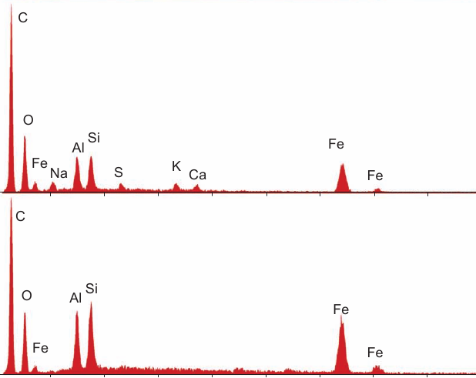
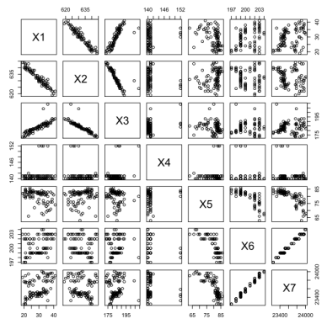
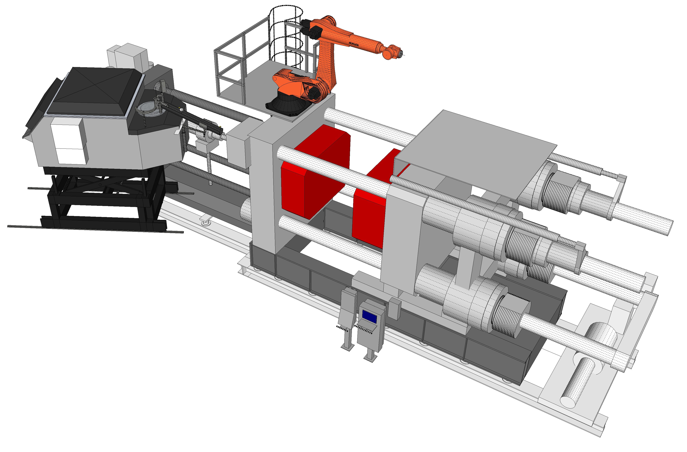
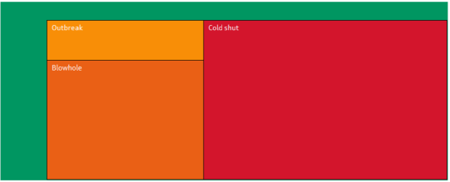
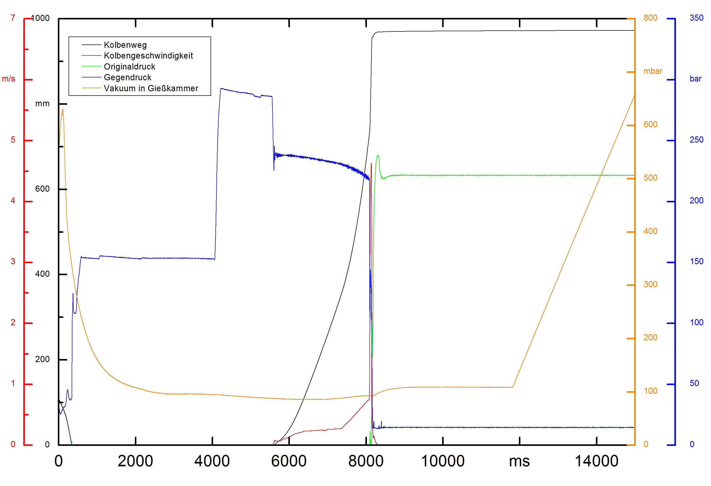
Predictive Analytics in High Pressure Die Casting Pattern recognition of historical data sets
→
Is it possible to use historical data for predictive analytics?
!
Data cleansing and preparation of existing data sets of the high pressure die casting process in order to train predictive models.
!
Usage of trained models inline during the casting process for the prediction of quality.
→
Workflow of prediction model training
HPDC process
Historical data sets
Process & Quality data
Prediction model
Training & Deployment
Visualization
Inline & Web based

Slide 14
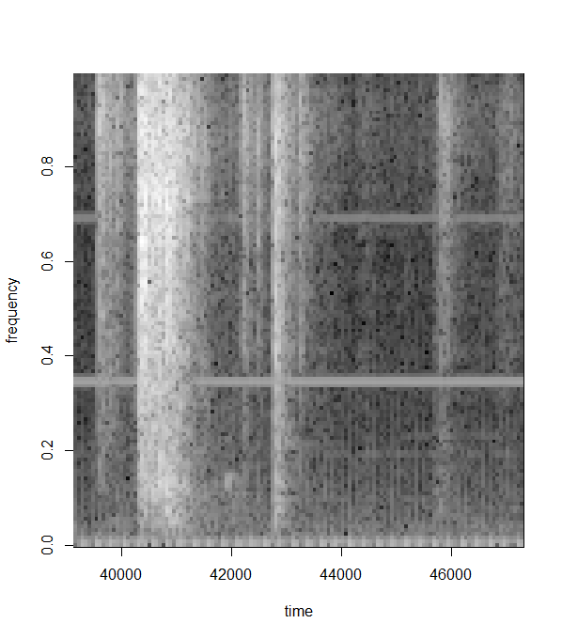
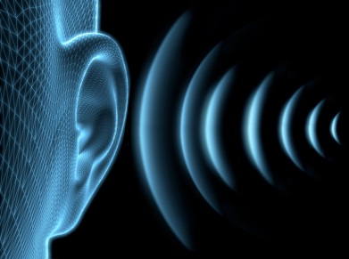
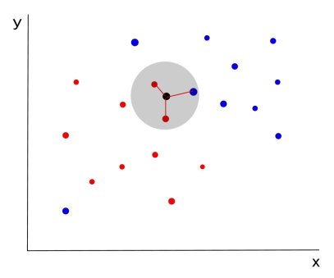
Predictive Analytics in High Pressure Die Casting Additional sensors for casting domain specific predictions
→
Which casting environmental parameters aren’t detected yet?
!
Detection of acoustic patterns during the casting process with worker feedback to store the worker knowledge of estimated good or bad parts.
!
Detection of correlations of part quality and changing weather conditions in the high pressure die casting foundry.
→
Extending the prediction model by acoustic and weather sensors
Acoustic measurements
FFT & Feature Extraction
Extended model
k-nearest or random
forest tree
Weather data
Correlation of Process data

Slide 15
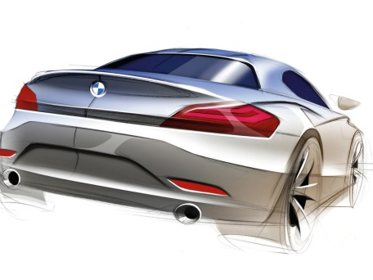
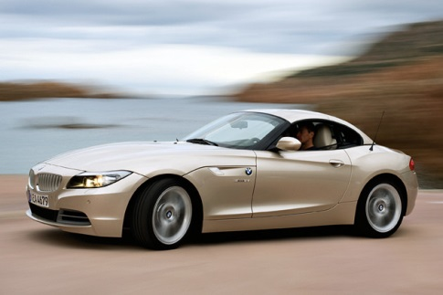
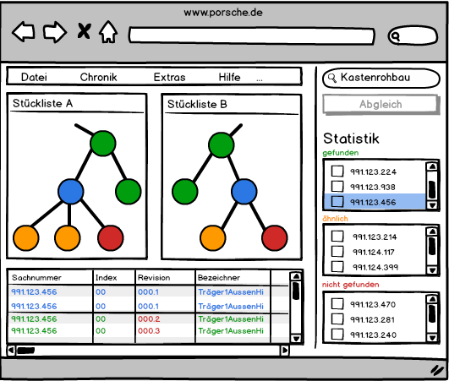
Comparison of huge list structures Initial situation and requirements
→
In Industry, real and digital prototypes are often developed in parallel, but independently
!
Challenge: Matching of different prototypes
? =
!
Are the products that are tested and simulated the same?
→
Matching of different lists (e.g. bill of materials)
!
Challenge: Matching of heterogeneous lists with thousands of elements
!
Are two lists respectively two elements equal or similar?
→
Objective: Automated matching of lists
!
Implementation of an intelligent matching algorithm for different scenarios
!
Traceable presentation of the matching results

Slide 16
Comparison of huge list structures Matching algorithm and procedures
→
Modular and adaptive matching algorithm
!
Intelligent configuration and selection of several procedures in 4 phases
!
Identification of matching scenarios based on list meta data
→
Equality and similarity calculation
!
Similarity measure by means of numerous matching procedures (Sift, Levenshtein, …)
!
List of candidates enables high traceability
→
Different strategies for element matching
!
Greedy algorithms vs. optimization of total list similarity
!
Consideration of structural information
→
Up to few seconds of matching time

Slide 17
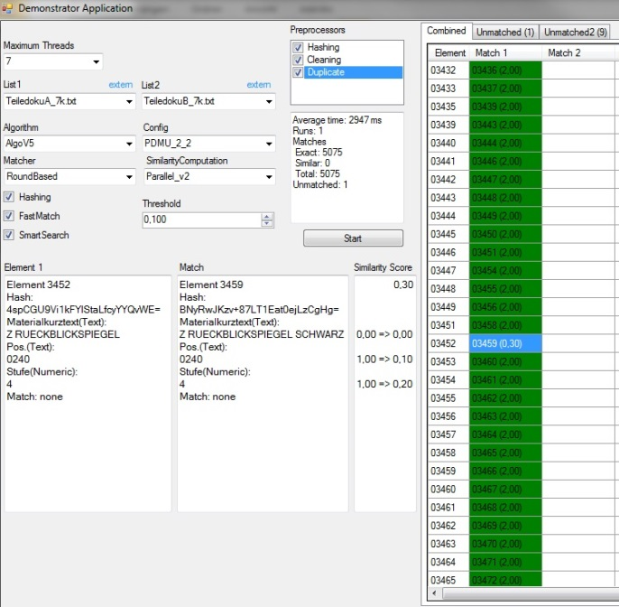
Comparison of huge list structures Matching tool for control and result presentation
→
Visual Analytics demonstrator: “Overview first, zoom and filter, details-on-demand”
Configuration of lists and matching scenarios
List of candidate of similar elements from list B for every element from list A
List matching and performance results
Element matching results

Slide 18
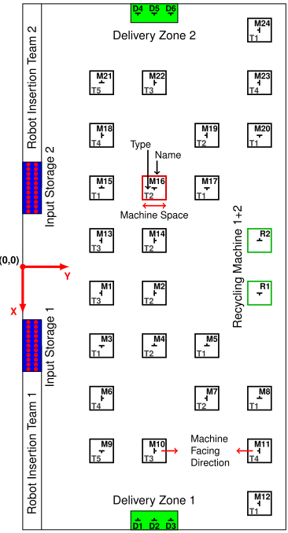
Gameplay Analysis RoboCup Logistics League
→
RoboCup Logistics League
!
I4.0/CPS-inspired production scenario
!
Autonomous Intralogistics and adaptive process planning
!
Agent-based Cooperations
Product
Machine

Slide 19
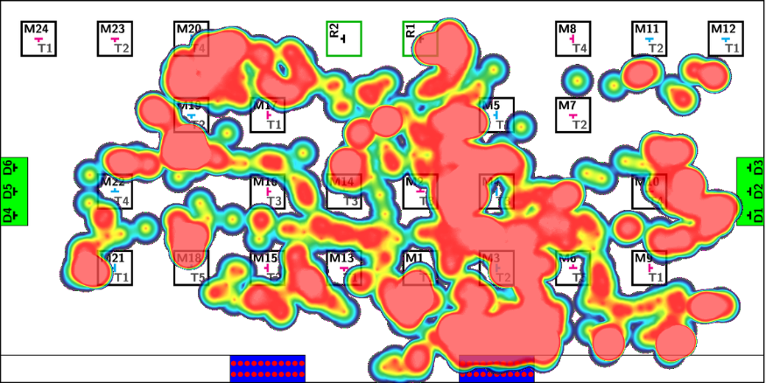
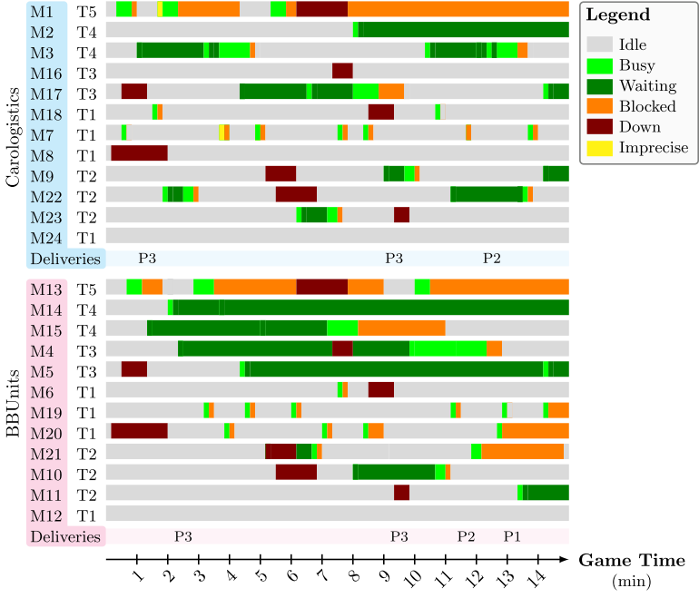
Gameplay Analysis RoboCup Logistics League
→
Goal: Identification of KPIs
!
Data: 75 GB of Logs
Communication data
state changes of internal knowledge-base
text logs and reports

Slide 20
Summary

Slide 21
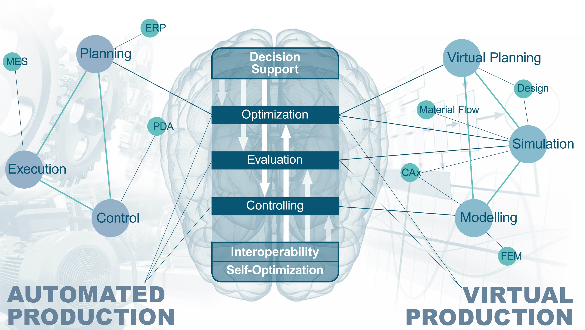
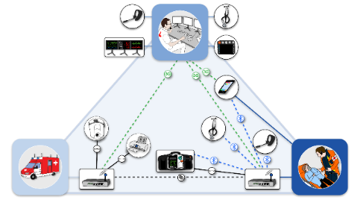
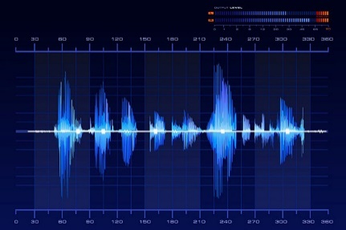
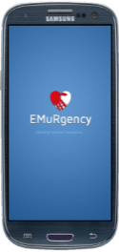
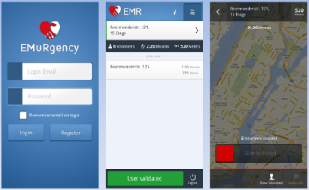
Summary Interdisciplinary problems
→
Data Science is not only exciting, it happens now and opens up possibilities in manifold practical domains…
… but it is an interdisciplinary challenge, solved by many, not by one!
84%
Production technology
Health
… and many more
!
So let join forces!

Slide 22
Thank you!
Dr.-Ing. Dipl.-Inform. Daniel Ewert
Research Group Leader Engineering Cybernetics
Phone: +49 241 / 80 911 28
daniel.ewert@ima-zlw-ifu.rwth-aachen.de
Co-authored by:
Prof. Dr.-Ing. Tobias Meisen
Managing Director IMA
Phone: +49 241-80-91130
tobias.meisen@ima-zlw-ifu.rwth-aachen.de
Dr.-Ing. Dipl.-Inform. Christian Tummel
Research Group Leader: Agile Management & eHumanities
Phone: +49 241-80-91142
christian.tummel@ima-zlw-ifu.rwth-aachen.de
www.ima-zlw-ifu.rwth-aachen.de

